Slide 1
Unit 4 Days 6-10

Slide 2
Day 6

Slide 3
Bell Ringer
No bell ringer today! Happy NWEA testing!
Please turn in your first journal.

Slide 4
Day 7

Slide 5
Bell Ringer 2
Thinking about the historical context we have talked about, what are two things that you are interested in learning more about? What are you still wondering about?
While you work, I am going to pass back papers.
Heads Up: Journal 2 due next class (change from our previous schedule).

Slide 6
Plan for the Day
Irony
Read Scene 4
Introduction to Research Paper
Read Scene 5???????

Slide 7
Anne Frank Scenes 1-3 Pink Sheet

Slide 8
Irony
Irony: When the opposite of what you expect to happen, happens.
Usually something is out of place, unexpected, or funny

Slide 9
Verbal Irony
Verbal Irony: The use of words to mean something different from what a person actually says. (Basically sarcasm)
“Thanks for the ticket officer! You just made my day!”
NOT “You call this a work of art?”

Slide 10
Situational Irony
Situational Irony: When the opposite of what is supposed to happen, happens.
Example: Someone is allergic to allergy medicine.

Slide 11
Dramatic Irony
Dramatic Irony: When the audience is aware of something that the characters in the story are not aware of.
Popular in movies, books, poems, and plays.
Think about horror movies.
Toy Story: the audience knows the toys are alive, but the people in the movie don’t.

Slide 12
Scenes 4 (396-400)
As we read, pay attention to the different examples of irony.

Slide 13
Research Project Description
The next two class periods, you will have the opportunity to research for your paper. You will work in small groups, and we will have students from other English 8 classes working with you.

Slide 14
Topic Selection
Your research paper must be about the Holocaust or World War II. Other than that, your research group may select any topic that you like.

Slide 15
Research Paper Outline

Slide 16
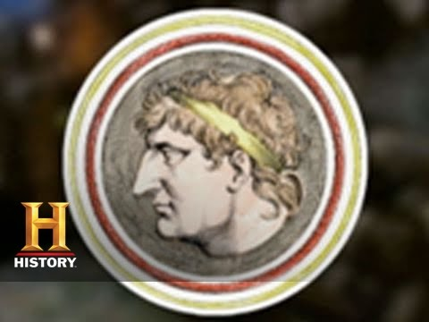
Hanukkah

Slide 17
Scene 5 (401-409)

Slide 18
Reading Guide Work Time (Pink and Blue)

Slide 19
Day 8

Slide 20
Bell Ringer
No bell ringer today!
Please find me at the Learning Stairs. Bring all your materials with you.

Slide 21
Day 9

Slide 22
Bell Ringer
No bell ringer today!
Please find me at the Learning Stairs. Bring all your materials with you.

Slide 23
Day 10

Slide 24
Bell Ringer

Slide 25
Plan for the Day

