Slide 1
Unit 3 Days 1-5

Slide 2
Day 1

Slide 3
Bell Ringer
Why is it important to be smart? How do people treat those who are not seen as “smart”?
Get out your identity projects. Also make sure you have your copy of Breaking Night with you.

Slide 4
Plan for the Day
Identity Projects
Intro to Unit 3
“Two Kinds of Intelligence”
Intro to “Flowers for Algernon”

Slide 5
Identity Project Gallery Walk

Slide 6
Essential Questions
What does it mean to be intelligent?
How does a person acquire knowledge? Intelligence? Is there a difference between the two?
How does one’s intelligence affect one’s human experience?
What happens when people are greedy for knowledge?

Slide 7
Texts and Projects
“Flowers for Algernon” by Daniel Keyes
Frankenstein by Mary Shelley
Argumentative Speech
You have to convince your audience to believe what you believe.
Based on science and morality (Ex: Is human cloning right?)

Slide 8
To introduce the topic of “intelligence”…
We are going to do “Would you Rather?”
Some questions relate to our unit, some do not.

Slide 9
Would you rather...
Go into the past and meet your ancestors?
Go into the future and meet your great-great grandchildren?

Slide 10
Would you rather...
Have a rewind button on your life?
Have a pause button on your life?

Slide 11
Would you rather...
Be able to speak to animals?
Be able to speak all foreign languages?

Slide 12
Would you rather...
Be able to read minds?
Be able to tell the future?

Slide 13
Would you rather...
Not have elbows?
Not have knees?

Slide 14
Would you rather...
Be smart?
Be funny?

Slide 15
Would you rather...
Be smart, but know that people hate you?
Be dumb, but not know that people hate you?

Slide 16
Would you rather...
Be physically fit/strong?
Be smart?

Slide 17
Would you rather...
Be good looking?
Be smart?

Slide 18
Would you rather...
Be smart, but know that people hate you?
Be dumb, but not know that people hate you?

Slide 19
Would you rather...
Know everything for 5 years, but then you die?
Have a below average intelligence, and live for a normal amount?

Slide 20
Rumi’s “Two Kinds of Intelligence”
1. Tape the poem into your notebook.
2. Annotate the poem.
3. Describe the two types of intelligence. Which one is more common or thought of?
4. Which type of intelligence do you think is the most important?
5. Make some connections to something outside of the text. What does this poem remind you of?

Slide 21
Homework:
Pages 9 and 10 in yellow narrative packet (due Tuesday)
Speech topic
Do some preliminary research.
What areas of science are you interested in?
Write down 3 topics that you might want to research more.

Slide 22
Day 2

Slide 23
Bell Ringer
When do you think "Two Kinds of Intelligence" was written? Explain your answer with evidence from the poem.
When you are done, please get out your AOW.

Slide 24
Plan for the Day
Intro to Speech
10 Minute AOW discussion
“Flowers for Algernon” Reports 1-6
Homework:
Three speech topics

Slide 25
Your Argumentative Speech
Objective: Convince your audience to agree with you by the end of the speech.
Topic: Ethics in Science and Technology

Slide 26
Some Speech Topic Ideas
Designer Babies/Gene Editing
Cloning
Organic Foods
Factory Farms
3D Printed Organs
Driverless Cars
Colonization of Mars
Wearable Technology
Organ Donation
Data Privacy
Pollution
Weapon Development
Drones
Artificial Wombs
Google Clips

Slide 27
AOW Discussion

Slide 28
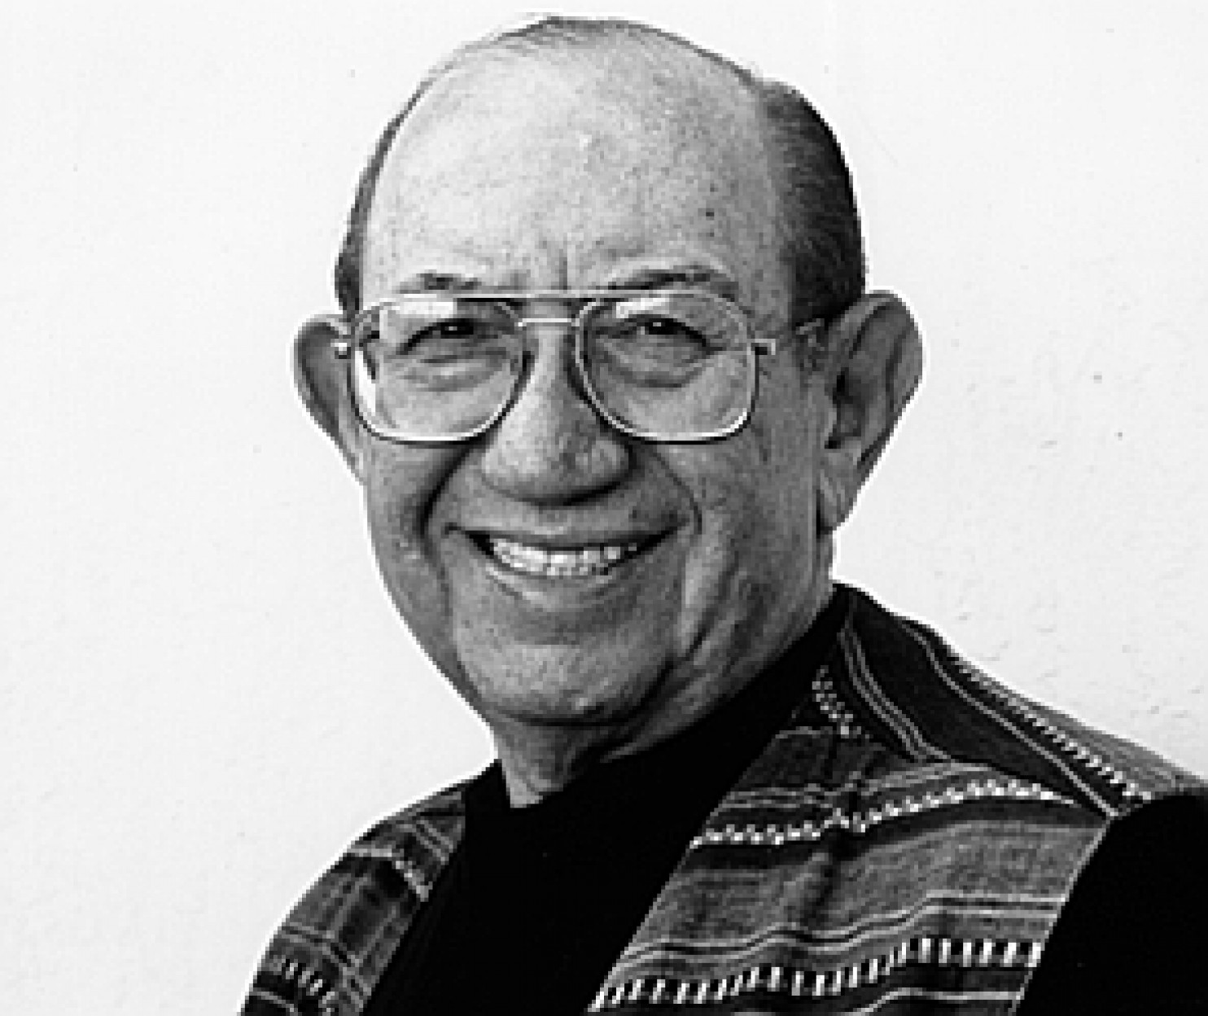
Daniel Keyes
Has a degree in Psychology, but went back to school to get his teaching license.
Taught English in NY, but continued writing on weekends.
Eventually became a college professor.
He’s a pretty smart dude.

Slide 29
“Flowers for Algernon” Background
Written in 1958, published a year later
Originally a short story, but was adapted into a novel in 1966.
It has NEVER gone “out of print” and has multiple awards.

Slide 30
Censorship and “FFA”
It has been “challenged” all over the US and Canada because it is “inappropriate” for young readers (but we’re ignoring that)
Schools in Pennsylvania and Texas succeeded in getting the book removed from school libraries.
It is #4 on the American Library Association’s list of 100 Most Frequently Challenged Books of 1990-1999

Slide 31
“Dear Algernon” by Kyosuke Hirumo

Slide 32
“Dear Algernon” Lyrics
https://www.paroles-musique.com/eng/Kyosuke_Himuro-Dear_Algernon-lyrics,p07629142
Turn and talk: Based on the lyrics and the video, what do you think “Flowers for Algernon” is going to be about? Also consider the tone/mood.

Slide 33
FFA Vocabulary (Page 32 and 33)
Word: | Synonym to Match:
Misled | Conceal
Tangible | Supposition
Refute | Deceived
Invariably | Self-examining
Regression | Always
Verified | Real
Obscure | Disprove
Deterioration | Confirmed
Hypothesis | Reversal
Introspective | Worsening

Slide 34
Answers
Misled (C) Deceived
Tangible (F) Real
Refute (G) Disprove
Invariably (E) Always
Regression (I) Reversal
Verified (H) Confirmed
Obscure (A) Conceal
Deterioration (J) Worsening
Hypothesis (B) Supposition
Introspective (D) Self-examining

Slide 35
Let's Read!
"Flowers for Algernon” Reports 1-6 (33)

Slide 36
Day 3

Slide 37
Bell Ringer
Make a prediction about what is going to happen to Charlie. What do you think the story is going to be about? Consider the title of the story when making your prediction.

Slide 38
Plan for the Day
IR Journal
Finish Reports 1-6
Plot Notes
“Flowers for Algernon” Reports 7-9
Parallel Episodes

Slide 39
IR Journals (Quarter 2)

Slide 40
Let's Read!
"Flowers for Algernon” Reports 1-6 (33)

Slide 41
Your Homework
Find, read, and annotate two articles about your speech topic.

Slide 42
Credibility
Turn and talk to your table clump people about the following questions:
1. What does it mean to be "credible?"
2. What should you look for when deciding whether or not an article is "credible?"
3. How might our specific speech topics make credibility especially important?

Slide 43
What to look for...
A recent article (within 10 years, but ideally within 5)
An author who knows what s/he is talking about
A publisher who is unbiased

Slide 44
Where do I find articles?
Google
https://owatonnamedia.symbaloo.com/home
ELM Middle School-->Explora Teens

Slide 45
Questions on your homework???

Slide 46
Plot and Subplots
Plot: the events of a story.
Subplots: a plot that is related to but less important than the main plot of a story.

Slide 47
Subplot Examples
Subplots are a part of almost every TV show ever.
Think about shows like “Friends,” “Bob’s Burgers,” and “Parks and Rec.”

Slide 48
Parallel Episodes
Two lines of plot that are woven together with a common character or theme.

Slide 49
Reports 7-9

Slide 50
In your notes...
Create a Venn Diagram with two circles. Then Compare/Contrast the two drinking episodes with Joe and Frank.
Drinking Episode 1: (40-41)
Drinking Episode 2: (42-44)
You may work with a partner for this activity.

Slide 51
Day 4

Slide 52
Bell Ringer
What are you doing for the outdoor field trip?
Reminder: Conferences are tomorrow night!
Please have your journal out on your desk.

Slide 53
Plan for the Day
Finish Reports 7-9
“Flowers for Algernon” Reports 10-11
Vocab Race
Charlie's Character Development
Homework: Two more articles

Slide 54
Finish Reports 7-9

Slide 55
In your notes...
Create a Venn Diagram with two circles. Then Compare/Contrast the two drinking episodes with Joe and Frank.
Drinking Episode 1: (40-41)
Drinking Episode 2: (42-44)
You may work with a partner for this activity.

Slide 56
Progress Reports 10 and 11

Slide 57
Vocab Race
I will split the class into two teams: "Charlie" and "Algernon."
Then each team will break into pairs.
One person needs to be a writer, the other is a runner.
Each pair will take turns identifying the key word based on the clue.
The first runner to put the correct answer on the front table scores a point for their team.

Slide 59
Character Development Chart

Slide 60
Day 5

Slide 61
Bell Ringer
What do you know about Frankenstein? Who is Frankenstein? What does he look like?
Please have your two articles out on your desk.

Slide 62
Plan for the Day
“Flowers for Algernon” May 23-June 10
Introduction to Frankenstein
Homework: Shelley (3-25)

Slide 63
Charlie’s Character Development
Big Moments:
The dishwasher
Relationships with others (Miss Kinnian and the doctors)

Slide 64
"Flowers for Algernon" May 23-June 10
After we read we will discuss parallel episodes again. Pay attention as we read so you can identify the parallel episodes.

Slide 65
Parallel Episodes and Sub-Plots
Make a list of all the parallel episodes that we have read about so far.
Make a separate list of the conflicts in the story that you believe are sub-plots.
Be prepared to share your answers.

Slide 66
Introduction to Frankenstein
The Year without a Summer, 1816
Galvanism
Industrial Revolution
The Enlightenment
Romanticism
You have 10 minutes to investigate your term. You will then teach the class the BASICS (no need to dig super deep into your topic).

Slide 67
Be smarter than Google:

Slide 68
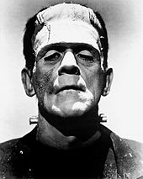
The Creature
(or Monster)
Victor Frankenstein

Slide 69
The Making of Frankenstein (Start at 1:55)

Slide 70
Science!!! (Stop at 3:27)

Slide 71
Your homework...
Read pages 3-25
Fill out "The Letters" portion of the green packet
Expect to have me initial your work at the start of class.
Come grab a book from the cabinet! You should have the same number as Breaking Night.

Slide 72
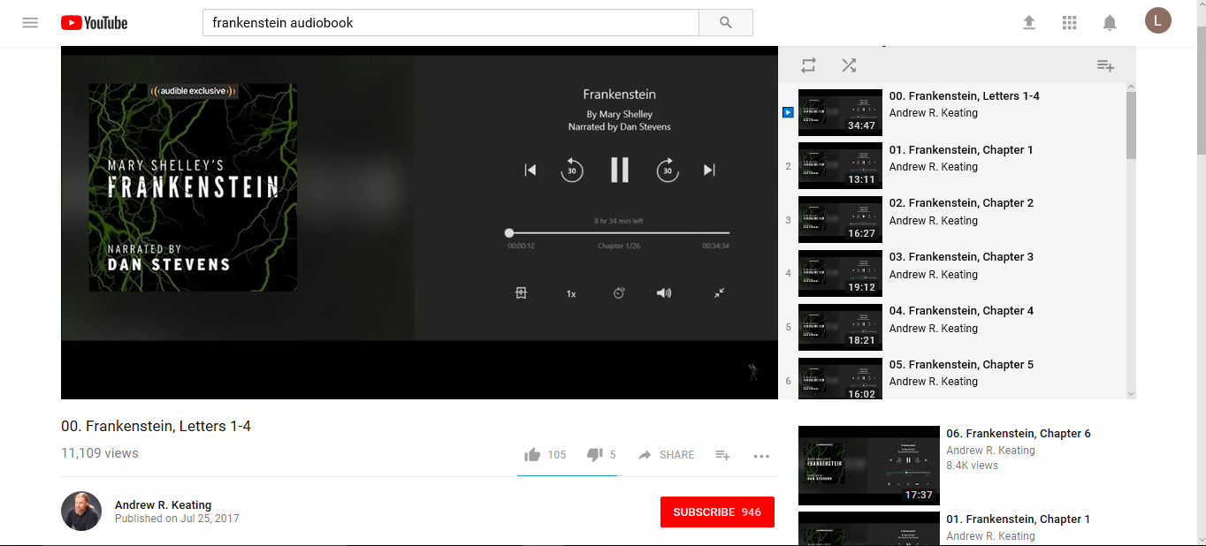
Struggling with the vocab?
Victorian Language Dictionary (back of the book)
Listen to the book!
Andrew R. Keating

