Slide 1
Unit 1 Days 6-10

Slide 2
Day 6

Slide 3
Bell Ringer
If a teacher is using a section of Beyoncé's album Lemonade to teach her students about figurative language, would that break copyright?
Why or why not?
Answer the prompt in 3-5 sentences.

Slide 4
Pass in your music streaming article

Slide 5
Plan for the Day
Essay pre-assessment
Read

Slide 6
Essay Pre-Assessment
Directions:
Write a 5 paragraph essay.

Slide 7
Day 7

Slide 8
Bell Ringer
Think of a job that you may want to have in the future. How does that job involve writing?
When you are done, please get your notebook page set up. The title is "6 Traits of Writing."

Slide 9
Plan for the Day
What makes a good writer?
6 Traits Stations
Formal E-mails on Office 365

Slide 10
What makes a good writer?
STEP 1: Brainstorm by yourself.
STEP 2: Share your list with your table.
STEP 3: Pick your top 10 qualities and write them on sticky notes.

Slide 11
6 Traits of Writing
Ideas: the main message
Organization: the structure of your writing
Voice: the author's tone or "flavor"
Word Choice: vocabulary
Sentence Fluency: the rhythm
Conventions: grammar, spelling, punctuation

Slide 12
6 Trait Sort
Take your table's list of the qualities of a good writer and label them with the 6 Traits.

Slide 13
Stations
Station 1: Organization
Station 2: Voice
Station 3: Sentence Fluency
Station 4: Conventions A
Station 5: Conventions B

Slide 14
Day 8

Slide 15
Bell Ringer
What is the most important of the 6 Traits? Which trait do you struggle with the most as a writer?

Slide 16
Plan for the Day
Finish 6 Traits stations
Marking the text
Textual evidence

Slide 17
Finish 6 Trait Stations
Station 6: Ideas
Station 7: Word Choice
Station 8: Book Hooks

Slide 18
Formal E-mails
To practice the 6 Traits (or the 4 that we focused on today) you are going to write me a formal e-mail using Office 365.
You may pick from one of the following prompts:
What's better: cats or dogs? Why?
What are you looking forward to during Homecoming week?
What's your favorite subject? Why?
Other

Slide 19
Marking the Text (Feedback)

Slide 20
Textual Evidence
QUOTES.
NOTE:
Quotes are NOT in quotation marks in the original article.
YOU put them in quotation marks when you take someone else's words.

Slide 21
Practice Identifying Textual Evidence
An important part of a child’s life is summertime. With year-round schedules, students would hardly have any time to relax. During the 15-day breaks, they would be thinking about their quick return to school. It would also be difficult to coordinate family vacations with parents’ work schedules. Similarly, children would not be able to go to most summer camps. One expert, Dr. Peter Scales, says, “The biggest plus of camp is that camps help young people discover and explore their talents, interests, and values. Most schools don’t satisfy all these needs. Kids who have these kinds of [camp] experiences end up being healthier and have fewer problems.” Obviously, the summer is crucial to a child’s learning and development. Why should this invaluable part of a young person’s life be taken away? (https://k12.thoughtfullearning.com/studentmodels/summer-15-days-or-2-12-months)
Notes:
What is the author's opinion on year-round school?
How do short breaks impact family vacations?
What are the benefits of summer camps?
What is your opinion on year-round schools? Use evidence to support your answer.

Slide 22
Day 9

Slide 23
Bell Ringer
What are you doing this weekend?

Slide 24
Plan for the Day
Citations
Quote Integration
Kahoot?

Slide 25
Citations
Works Cited
Dolby, Nadine. “Research in Youth Culture and Policy: Current Conditions and Future Directions.” Social Work and Society: The International Online-Only Journal, vol. 6, no. 2, 2008, www.socwork.net/sws/article/view/60/362. Accessed 20 May 2009.
USUALLY:
(Author'sLastName Page#)

Slide 26
Citations Handout: A Very Important Piece of Paper

Slide 27
Integrating Quotes
Signal phrase, "quote" (citation).

Slide 28
Kahoot!
https://play.kahoot.it/#/k/e092c2fc-a42f-4514-a8e6-4301aeb468dc

Slide 29
Day 10

Slide 30
Bell Ringer
What do you remember about plot?
If you are struggling, try to answer the following questions:
What is plot?
What are the six parts of the plot diagram?
What does a plot diagram look like?

Slide 31
Plan for the Day
Plot Review
"After Twenty" by O. Henry
Plot Diagrams

Slide 32
Plot Review
Plot: a series of events that creates a story

Slide 33
The Six Parts of the Plot Diagram
Exposition: background information; characters and setting introduced
Turning Point: conflict/problem introduced
Rising Action: conflict builds
Climax: most interesting moment; conflict reaches its peak
Falling Action: conflict starts to resolve
Resolution: conflict ends

Slide 34
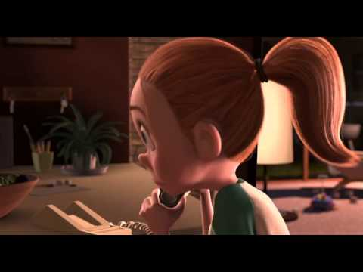
Plot Diagram Practice

Slide 35
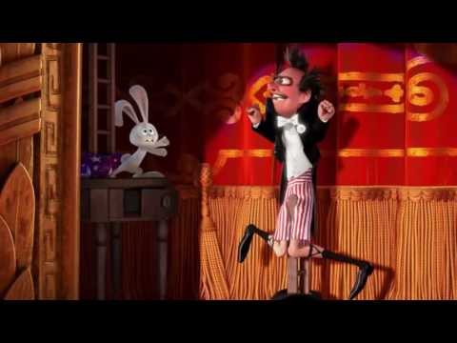
Plot Diagram Practice 2

Slide 36
"After Twenty Years" by O. Henry

Slide 37
"After Twenty Years" by O. Henry
Re-read the story with your table group.
Assign each person to one of the following tasks:
List 10 plot events.
Identify the clues that tell the reader that something is "off" with Jimmy.

Slide 38
Plot Diagram Practice
Step 1: Share your plot events with your table.
Step 2: Narrow down the list to your top 12 events. (EACH GROUP MUST HAVE 12 EVENTS).
Step 3: Write the events on sticky notes (One event per note).
Step 4: Plot Diagram Competition

