Slide 1
Unit 1 Days 16-20

Slide 2
Day 16

Slide 3
Bell Ringer
Write a level 1, 2, and 3 question about ONE of the following topics:
Beyoncé
The Super Bowl
Your independent reading book
"The Circuit" (Panchito, migrant farmworkers, school)

Slide 4
Plan for the Day
Wrap up "The Circuit" (plot diagram)
Theme Review

Slide 5
Important Dates
Assignment | Date
Fiction Quiz (Plot and Theme) | November 2nd
Nonfiction Quiz (Annotation, Summaries, Questioning) | November 9th
Book Talks | November 13th and 15th

Slide 6
Pass in your bell ringers.
MAKE SURE YOUR NAME IS ON IT.

Slide 7
"The Circuit" Plot Diagram Wrap Up

Slide 8
Theme
Theme: the main idea; the lesson the author wants the reader to understand.

Slide 9
Themes vs. Topics
Theme is NOT one word (example: family, love, revenge).
TOPICS are one word. THEMES are a full sentence about a topic.

Slide 10
Identifying Theme
Read the text.
Make a list of topics.
Pick ONE topic.
Fill out the theme web.
Finish the sentence "The author believes that..."

Slide 11
Practice Identifying Theme
Movie | Topics (List 4) | Theme "The author believes that..."
https://www.youtube.com/watch?v=tvKzyYy6qvY&list=PLGniCcA0UBfEa6j7ZljW_lceQM83kU_94

Slide 12
Star Wars (by special request)
https://www.youtube.com/watch?v=Q0CbN8sfihY

Slide 13
Theme Web: A Very Helpful Document

Slide 14
Theme and "After Twenty Years" (together)

Slide 15
Your Homework...
Listen to 3-5 songs and identify each song's theme.
Grading Scale:
7: 3 songs with evidence
10: 5 songs with evidence

Slide 16
Example: https://www.youtube.com/watch?v=LRKiftk6ffQ
"Tearin' Up My Heart" by NSYNC
Theme: Love can cause both happiness and pain.
Evidence:
Topic: Love
Conflict: Narrator is in a troubled relationship but loves the other person.
Response to Conflict: Sings a sad song about it and asks the other person to make a decision about their relationship. Dances problems away.
Tone and Mood: Moody and sad, but jazzy
Thoughts and Feelings: Heartbroken, frustrated. Wants to find a solution.
Lessons: Relationships are complicated.
TextEv: “It’s tearin’ up my heart when I’m with you, but when we are apart I feel it too”

Slide 17
Day 17

Slide 18
Bell Ringer
What were you like when you were in kindergarten? (Did you listen? Were you terrible?) Do you think that a child's behavior in kindergarten tells you what s/he is going to be like as an adult? Why or why not?
Remember, all of your bell ringers should be 3-5 sentences if you want full points!

Slide 19
Plan for the Day
“Charles” by Shirley Jackson

Slide 20
Turn in your Theme Practice (Songs)

Slide 21
Theme and "The Circuit" (with your team)

Slide 22
"Charles" by Shirley Jackson
Read the story with your group. You should take turns reading it aloud.

Slide 23
“Charles” Discussion Questions
For a 10:
-Answer in full sentences.
-Provide textual evidence for each answer.
Vocabulary Study
Re-read the first three paragraphs. How does Laurie change after his first day of kindergarten?
Go back and read through the story. List 5 signs that Laurie is actually Charles.
How would the story be different if Laurie were the narrator instead of the mom?
When do you think the story takes place? List 3 examples to support your answer.
In your opinion, what caused the change in Charles? (Keep in mind that his MOM is the narrator and is therefore the only one giving us information).

Slide 24
Homework
For "Charles"…
plot diagram
theme web

Slide 25
Day 18

Slide 26
Bell Ringer
Turn in your theme web/plot diagram for "Charles."
After you turn it in, answer the following prompt in 3-5 sentences:
Create your own falling action and resolution for "Charles." What could have happened after the story ended on a cliffhanger?

Slide 27
Plan for the Day
Work Day
Vocabulary and "Charles" discussion
“Charles” Nonfiction
Corporal Punishment Article
Missing/re-do assignments
IR Project

Slide 28
Nonfiction Summaries (Handout)

Slide 29
“Charles” Discussion Questions
For a 10:
-Answer in full sentences.
-Provide textual evidence for each answer.
Vocabulary Study
Re-read the first three paragraphs. How does Laurie change after his first day of kindergarten?
Go back and read through the story. List 5 signs that Laurie is actually Charles.
How would the story be different if Laurie were the narrator instead of the mom?
When do you think the story takes place? List 3 examples to support your answer.
In your opinion, what caused the change in Charles? (Keep in mind that his MOM is the narrator and is therefore the only one giving us information).

Slide 30
Day 19

Slide 31
Bell Ringer
Do you think that ghosts are real? Why or why not? Do you have a good ghost story? If so, be prepared to share!
Turn in your blue article (with annotations!)

Slide 32
Plan for the Day
“The Tell-Tale Heart”
Theme and Plot Review

Slide 33
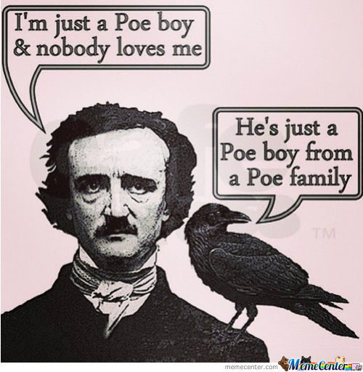
Edgar Allan Poe, a pretty weird dude
http://www.history.com/this-day-in-history/edgar-allan-poe-is-born

Slide 34
More Weird Facts about Poe
He married his first cousin in a secret ceremony (She was 13, he was 26)
He spent his time writing, gambling, and drinking (which is not a good combination)
He disappeared for a week, and then was found at a bar in another man's clothes. He died a few days later after suffering from strong delusions.
Only 8 people went to his funeral :(

Slide 35
"The Raven"

Slide 36
Poe is kind of a big deal

Slide 37
"The Tell-Tale Heart" Preview
In your notebook, write THREE questions and TWO predictions you have about the story based on the following information:
Poe's biography
"The Raven"
The title of the short story
("The Tell-Tale Heart")
This image
The fact that it's Halloween, and I'm feeling festive.

Slide 38
"The Tell-Tale Heart"

Slide 41
With your table...
Fill out a plot diagram for "The Tell-Tale Heart"
Identify the theme of "The Tell-Tale Heart"

Slide 42
Day 20

Slide 43
Bell Ringer
Get out your notes on theme and plot. Use the first few minutes of class to study.
We will NOT be reading at the start of class. You will get reading time after your quiz.

Slide 44
Plan for the Day
Fiction Quiz

Slide 45
Review before your quiz...
https://play.kahoot.it/#/k/264e25c8-8f17-4d68-8316-b7f090cc9440

Slide 46
"The Lottery"
https://www.youtube.com/watch?v=Wpl3nFL7-yQ

Slide 47
Your Quiz
Fill out a plot diagram and a theme web for "The Lottery."
Be as thorough as possible.
When you are done, turn in your quiz to the basket and then read your IR book.

