Slide 1
Unit 4 Days 1-5

Slide 2
Day 1

Slide 3
Bell Ringer 6
Lesson started after speeches (see last day of Unit 3)

Slide 4
Plan for the Day
Speeches!
Intro to Unit 4

Slide 5
Unit 4
Unit Topic: The Human Spirit​
Unit Focus:​
Research synthesis​
Review of big ideas​
Anchor Text: “The Diary of Anne Frank”

Slide 6
Essential Questions
What does it take to overcome obstacles?​
How do people cope with daily life under difficult circumstances?​
Does good always triumph over evil?​
What does it mean to be a survivor?

Slide 7
Unit 4 Pre-Work
Start a new page in your notebook and title it "Unit 4 Pre-Work."
All the work that you do over the next two class periods (other than bell ringers) should go on this page.

Slide 8
Quick Write
What are your thoughts about this poem?
What does it mean?
What is it talking about? Make as many connections to history that you can.

Slide 10
Images of the Holocaust
For each image, jot down a few thoughts. Don't overthink it. Just write down your reactions.

Slide 15
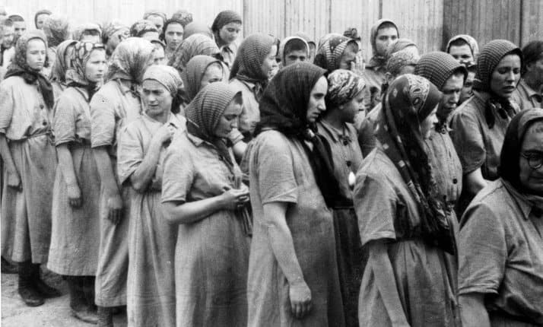

Slide 24
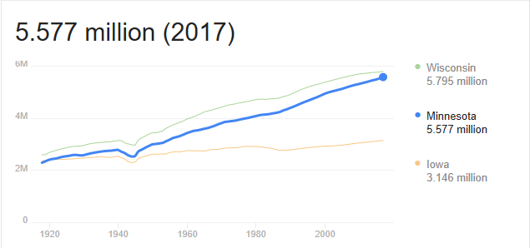

Slide 25
Day 2

Slide 26
Bell Ringer 7
Last class we learned a lot about the Holocaust and how Jews were treated. What are two things you remember from what we talked about?

Slide 27
Plan for the Day
Continue Unit 4 Pre-Work
Start reading DoAF?

Slide 28
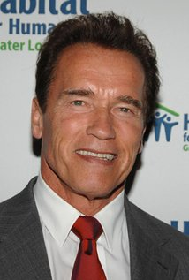
Modern Connections to the Holocaust

Slide 29
2B: Images of the Holocaust

Slide 30
Background Research
Meet with your group. Decide who is going to read each article.
Read the article on your own. While you read, take notes on the important details on your pre-work page. Be prepared to share with your group.
Meet back with your group. Take turns sharing your information.
When you are done, leave your pre-work on your desk so I can check it. Then read or work on other homework.

Slide 31
During your group meeting...
Discuss: Share a summary of each article.
Write:
Three important facts from each article.
Three questions that you are wondering about.

Slide 32
1A
Group 1 | Group 2 | Group 3 | Group 4 | Group 5 | Group 6 | Group 7
Taylor | Nate | Lexi | Marlee | Zander | Joab | Koi
Aidan | Anas | Nolan | Ryley | Jenna | Landon | Laura
Melby | Anna | Elijah | Brynn | Ali | Izaya | Parker
Alec | Kya | Chris |  | Payton | Nya

Slide 33
3A
Group 1 | Group 2 | Group 3 | Group 4 | Group 5 | Group 6 | Group 7
Hunter | Gavin | Ariana | Ezra | Avery | Marina | Julia
Alya | Hailey | Emelia | Ty | Mason | Abigale | Dylan
Brenden | Riley | Momo | Aderi | Ian | Luke | Korban
Grace | Joe | Wylie | Brianne | Momo | Corey | Jack

Slide 34
1B
Group 1 | Group 2 | Group 3 | Group 4 | Group 5 | Group 6 | Group 7
Nena | Nyagam | Isaiah | Celina | Liam | Mariela | Ethan
Abdi | Katy | Addie | Chevy | Ella | Linders | Kaven
Jasmine | Nick | Avery | Hector | Kennedy | Jose | Sam
Alexis | Tanner | Zahra | Marisol | Ralph | Auna | Dylan

Slide 35
2B
Group 1 | Group 2 | Group 3 | Group 4 | Group 5 | Group 6
Ava | Jacob | Ava | Taylor | Paige | Logan
Josh N. | Kyla | Taylor | Sky | Maya | Jenna
Kylie | Ethan | Sami | Brayden | Dominique | Fernando
Aiden | Josh R. |  |  | Hoover | Walker

Slide 36
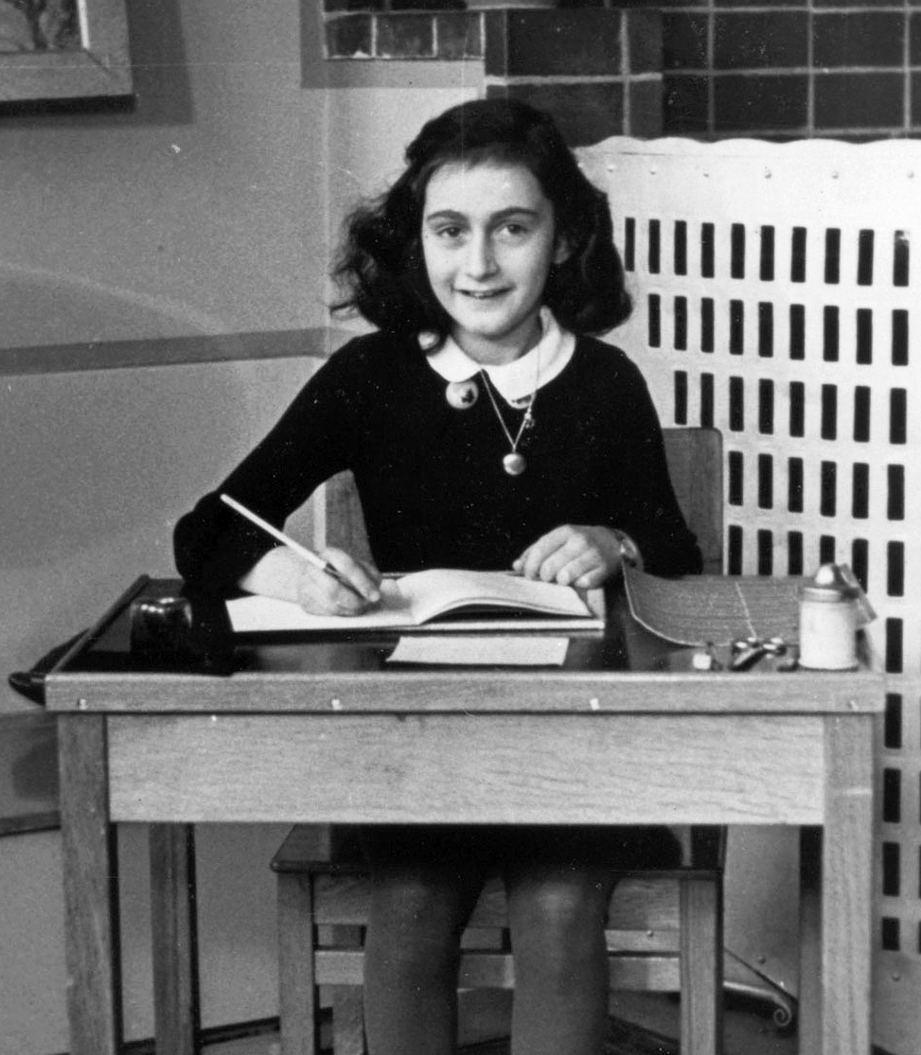
The Story of Anne Frank
http://www.annefrank.org/en/Subsites/Home/Enter-the-3D-house/#/house/20/

Slide 37
More Info on Anne Frank
Read “Background: Literature and Life” (365-366)

Slide 38
Day 3

Slide 39
Bell Ringer 8
We know what happens to Anne and her family. How does this change how we react to the story?
When you are done, put your name on your bell ringers and put them in the basket.

Slide 40
Plan for the Day
Quarter 4 IR Project
Mapping the Annex
Read Scenes 1-2
Reading Guides

Slide 41
Quarter 4 IR Project
Journals (due every other week)
You only need to complete THREE of the journals, but you do need to finish your book.
Journal 1: 8th/9th
Journal 2: 14th/15th
Journal 3: 22nd/23rd
Comic Strip: Due May 22nd/23rd

Slide 42
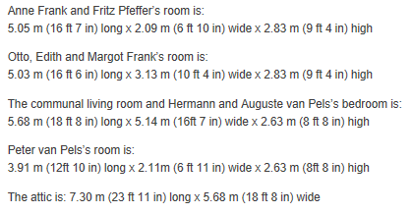
Mapping the Annex
8 people live in the annex for 2 years

Slide 44
“The Diary of Anne Frank” Scenes 1-2
We are going to read the script aloud. Everyone needs to read at LEAST twice.
It does not matter how small the role is, you still need to practice reading aloud.
Read once: 8/10 Read twice: 10/10

Slide 45
“Diary of Anne Frank” Reading Guides
Other than your IR project and your research project, this will be your only homework for the rest of the year…probably.
Take the rest of class to start the reading guides with your group.

Slide 46
Day 4

Slide 47
Bell Ringer 1
What do you think of the play so far? Is it what you expected it to be? Why or why not?
B Day: Turn in your journal. Then read your IR book silently.

Slide 48
Plan for the Day
2B: Finish reading scene 2
DoAF Movie: Scenes 1-3
Characterization and Conflict review

Slide 49
Movie!
While we watch, pay close attention to how the characters are represented in the film. After the movie (about 36 minutes) we are going to focus on descriptions of the characters.

Slide 50
Stand and Stretch for 30 Seconds!

Slide 51
Conflict Review
Turn and Talk: What are the types of conflict?

Slide 52
Types of Conflict New!
Person vs. Person
Person vs. Society
Person vs. Self
Person vs. Environment
Person vs. Supernatural
Person vs. Technology

Slide 53
Turn and Talk: Identify Conflict...
Identify each type of conflict in the texts we have read this year.
"Flowers for Algernon"
The Diary of Anne Frank
The Outsiders
"After Twenty Years"
"The Circuit"
"Charles"
"The Lottery"

Slide 54
Characterization Review
Is the character interesting?
Does the character change?
Flat: a simple character that the reader might not know a lot about
Round: complicated characters that the reader knows a lot about
Dynamic: a character who changes
Static: a character who stays the same

Slide 55
DoAF: Character and Conflict
With your Unit 4 group, you are going to describe the main characters in the play. Each person must do an equal amount of the work.
Group Folders

Slide 56
Work Time
Reading Guide
FINISH SCENES 1-3 AND KEEP WITH YOU.
Character and Conflict Packet PUT IN GROUP FOLDER BY THE END OF THE HOUR.
Reading/Journal 1 TURN IN BY THE END OF THE HOUR.
Missing Work

Slide 57
Day 5

Slide 58
Bell Ringer
No bell ringer today! Happy NWEA testing!
Please turn in your first journal.

