Slide 1
Unit 3 Days 6-10

Slide 2
Day 6

Slide 3
Bell Ringer
What does it mean to "pull a Charlie Gordon?" Support your answer with examples from the text.
When you are done, get out your IR book and read. Please have your journal out on your desk.

Slide 4
Plan for the Day
Progress Reports 10-11
Part 1 Review (quiz next class!)
Vocab Race

Slide 5
Vocab Race
To make sure that we all understand the story so far, we are going to have a vocab race.
I will split the class into two teams: "Charlie" and "Algernon."
Then each team will break into pairs.
One person needs to be a writer, the other is a runner.
Each pair will take turns identifying the key word based on the clue.
The first runner to put the correct answer on the front table scores a point for their team.

Slide 6
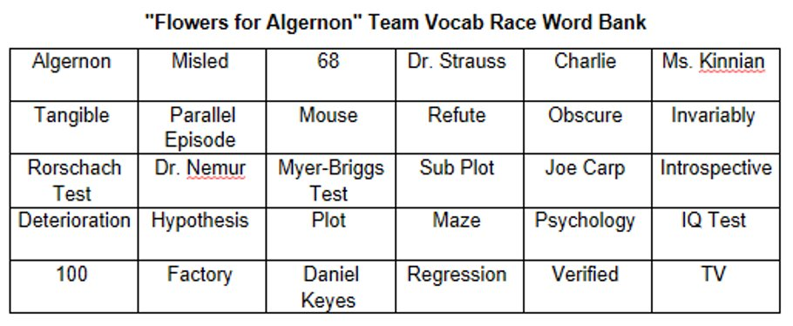

Slide 7
Progress Reports 10 and 11

Slide 8
Day 7

Slide 9
Bell Ringer 1
If you were Charlie, do you think you would have gotten the operation? Why or why not?

Slide 10
Plan for the Day
Progress Report 11
Part 1 Review
“FFA” Part 1 Quiz
Homework:
AOW due next class (3/7 or 3/8)

Slide 11
AOW Special Directions
In the article of the week, identify THREE sentences that stick out to you.
Be prepared to share these with your classmates.
Reminder: The expectation for AOWs is that you walk in the door with them FINISHED. This means that the article is annotated.

Slide 12
Progress Report 11 (48)

Slide 13
Page 50 #2-5

Slide 14
“FFA” Part 1 Quiz

Slide 15
Day 8

Slide 16
Bell Ringer 2
What is the difference between tone and mood? What is the definition of each of those words?
(If you can't remember, don't freak out! We are going over both of these terms today).
Have your AOW out on your desk.

Slide 17
Plan for the Day
AOW Discussion
May 15th-Progress Report 12
Tone and Mood Review

Slide 18
AOW Discussion
Person A shares ONE quote that stood out to them and why for 3 minutes.
Person B responds to Person A for 1 minute.
Person C responds to Person A for 1 minute.
Person A responds to what other people said for 1 minute.
Repeat until each person has shared for 3 minutes.

Slide 19
Tone and Mood Review
Tone: the attitude a writer takes towards the subject or the reader.
How does the author feel about the writing?
Look carefully at word choice and punctuation.

Slide 20
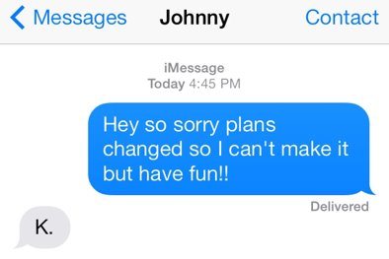

Slide 21
Tone Word Handout
Positive-Neutral-Negative Tone Words

Slide 22
Which passage has a kinder tone?
Move, Alex! It’s MY turn on the computer. You’ve been hogging it for the past hour.
OR
Would you please let me use the computer now, Alex? You’ve been using it for the past hour, so I think it’s my turn now.

Slide 23
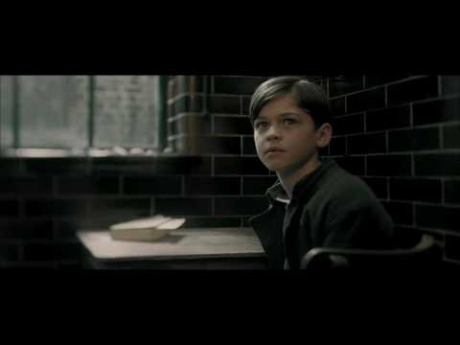
What's the tone of this video?

Slide 24
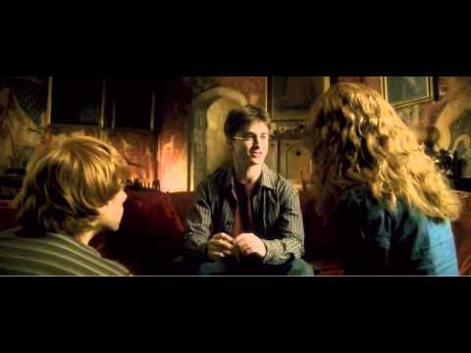
What's the tone of this video?

Slide 25
Mood
Mood: The atmosphere or emotion the writer creates for the reader.
How does the reader respond to the writing?
CAN be specific to the reader, but for class, think about how MOST people would react.

Slide 26
Day 9

Slide 27
Bell Ringer 3
Identify the tone of the following passage. Explain your answer with textual evidence:
Each year in the middle of February, when slush is underfoot and the sky is a depressing gray, I begin dreaming of warm beaches, tropical fruits and sunsets. If only I could save enough for a winter vacation! Maybe next year I’ll win the lottery. Meanwhile, I’ll read travel brochures and sigh.
A. unsure
B. joyous
C. longing

Slide 28
Plan for the Day
Continue parallel episodes and sub-plots
Progress Report 12-June 10

Slide 29
Identifying Sub-Plots
Sub-Plots
Make a list of the conflicts in the story (at least 5)
Then briefly map the conflict onto a plot diagram. We are almost to the end (resolution) of the story.

Slide 30
"FFA" Part 2 (51)
May 15th-Progress Report 12

Slide 31
Parallel Episodes
Identify the parallel episode in the section we read today. What moment in the story does this mirror?
What does this episode reveal about Charlie's character?
How has Charlie changed since the start of the story? What made him change?
How does this episode change Charlie's future actions? What is his motivation for continuing his work?

Slide 32
Maze Race!

Slide 33
Day 10

Slide 34
Bell Ringer 4
Identify the tone of the following passage. Then justify your answer in 3-5 sentences:
“Mr. Jones, since you obviously appear to know everything, would you like to come up here and teach this class for me?”
Sarcastic
Critical
Disrespectful

Slide 35
Plan for the Day
Progress Report 12-June 10
Introduction to Argumentative Speech

Slide 36
Progress Report 12-June 10 (55)
While we read, identify five words that you don't know the meaning of.

Slide 37
"FFA" Vocab.
Word | Sentence from "FFA" | Context Guess | Actual Definition IYOW

Slide 38
Your Argumentative Speech
Objective: Convince your audience to agree with you by the end of the speech.
Topics: Ethics in Science and Technology

Slide 39
Some Speech Topic Ideas
Wearable Technology​
Organ Donation​
Data Privacy​
Pollution​
Weapon Development​
Drones​
Artificial Wombs​
Google Clips
Designer Babies/Gene Editing​
Cloning​
Organic Foods​
Factory Farms​
3D Printed Organs​
Driverless Cars​
Colonization of Mars

Slide 40
By the end of class…
Explore the different links on the next slide.
Select a topic.
Turn in a half sheet of paper with your topic and a few sentences describing why you chose that topic.

Slide 41
Topic Exploration
https://www.newscientist.com/round-up/ethics-issue/
http://bit.ly/2Hsgg7d
http://bit.ly/2DZUlTp
http://ntrda.me/2Hr3R3j
http://ntrda.me/2FrxSDq

