Slide 1
Unit 3 Days 21-25

Slide 2
Day 21

Slide 3
Bell Ringer 4
Identify the evidence in the following passage:​
​
All whales belong in the ocean. Aquariums like Sea World have abused animals in the past as seen in the movie Black Fish. According to zoologist Phil Phlom, “87% of whales would be happier in the wild.”

Slide 4
Plan for the Day
Fact, Opinion, Bias
How to manipulate your audience

Slide 5
Fact
Fact: true information based on evidence
Example: 1 out of 3 American children eat fast food every day.

Slide 6
Opinion
Opinion: a personal belief or view
Example: English is the best subject in school.

Slide 7
Bias
Bias: an unfair judgement
Bias is created when…
Someone has incomplete information
Someone really loves something
Someone really hates something

Slide 8
Examples of Bias
A math teacher telling students that math is the most important subject​
The National Dairy Association writing an article telling people that drinking milk reduces the risk of cancer​
A celebrity selling a Nike shoe who is paid millions of dollars to endorse Nike

Slide 9
Practice determining fact, opinion, and bias
Read the passage
Identify facts and opinions
Determine if the passage has bias

Slide 10
Passage One
Reading for pleasure is a waste of time. People who spend hour upon hour reading don’t live in the real world. They don’t really learn anything that is useful about how to deal with everyday people and problems. Plus, teachers always make us read things that are boring.

Slide 11
Passage Two
Parents always talk about how if schools had uniforms, everything would be so much easier. You wouldn’t get caught up on looks and would learn the skills you need. I disagree with this, and I think that school uniforms would put a restriction on our creativity. We dress the way we do for a certain reason. Clothes give us expression and the ability to use color and patterns. The first impression we get of people is usually clothes, facial expression, and language. If we all wear the same thing, we don’t get to see what people are like on the inside. Usually girls wear pink and frilly things. Skaters wear baggy pants. Goths wear black. Clothes don’t distract us from learning, it simply lets us inspire our imaginations and lights up our worlds.​

Slide 12
Passage Three
Eating tomatoes is one of the best things you can do. These beautiful, red fruit not only thrill your taste buds and brighten your plate, they help fight disease. Studies show that people who eat tomatoes, and lots of them, lower their risk of cancer because tomatoes contain lycopene, a powerful antioxidant.​
-Tomato Farmers of America

Slide 13
How to Manipulate Your Audience Ad Sort
Sort the ads. There is no correct answer!
Take notes in your notebook on how you grouped the ads.
Be prepared to share

Slide 14
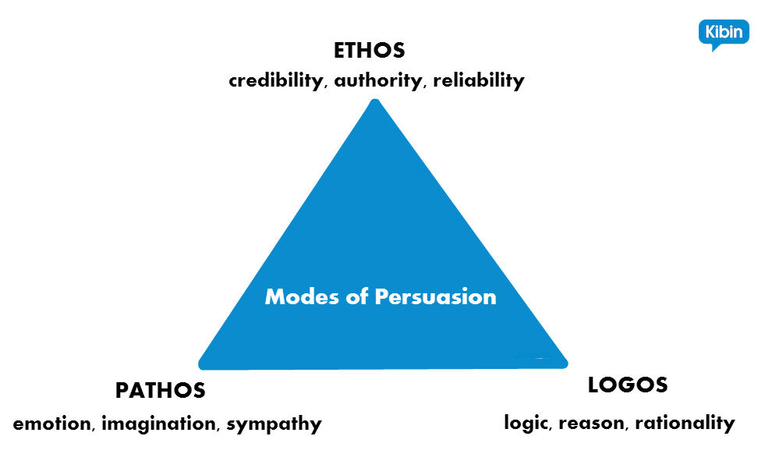

Slide 15
Ethos
The credibility of the speaker/writer.
Speaker/Writer-Audience/Reader trust

Slide 16
Pathos
An appeal to emotion.
Using an audience’s emotions makes them feel personally connected to the issue.
Be careful with this one!

Slide 17
Logos
The use of logic, reasoning, evidence, and facts to support an argument.

Slide 18
Turn and Talk: What would happen if you just had ONE of these? How many do you think a “good” argument should have?

Slide 19
Re-Sort the Ads

Slide 20
Examples of Ethos, Pathos, Logos in Commercials
While we watch, identify the PROMINENT technique. Some will use more than one, but each one has one that is used more than the others.

Slide 21
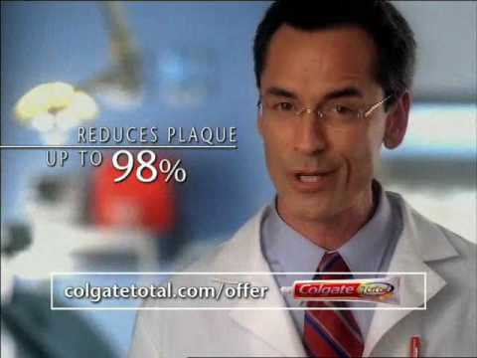

Slide 22
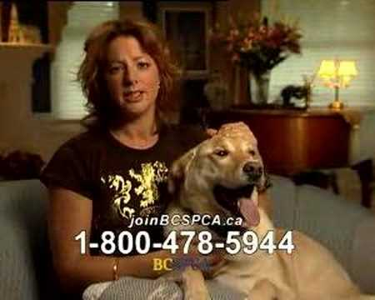

Slide 23
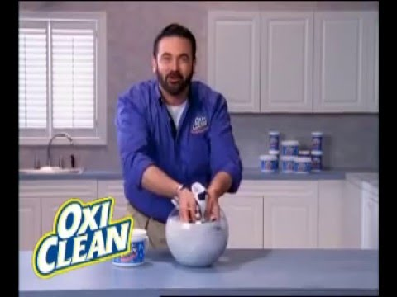

Slide 24
Argument Tree: Explanation
Fill in the explanation row of your argument tree. Use ethos, pathos, and logos whenever possible.
Conclusion:
Briefly summarize your speech.
Who cares? Why is this topic important?
When you are done, turn in your ACE tree and read.

Slide 25
Day 22

Slide 26
Bell Ringer 4
Define each of the following terms IN YOUR OWN WORDS. Then give an example of each.
Ethos
Pathos
Logos

Slide 27
Plan for the Day
Parts of a speech (intro, body, conclusion)
Outline work time

Slide 28
Introductions
Hook
Credibility Statement: Ethos; why should your audience trust you?
Argument*
Preview of Claims: “Today I am going to talk about x, y, and z”
Transition
*Already in your ACE diagram!

Slide 29
Types of Hooks
Tell a story
Share a startling fact
Ask a question
Share an “imagine if…“

Slide 30
Body Sections
Claim or Counter-Claim*
Evidence*
Discussion of Details/Importance*
Transition
*Already on your ACE diagram!

Slide 31
Conclusions
Summary of Main Points/Claims
Restate Argument
Concluding Statement: mic drop, connect back to your hook, discuss the importance of the topic, call to action

Slide 32
Example Outlines
https://studentowatonnak12mn-my.sharepoint.com/:w:/r/personal/afranklin1_student_owatonna_k12_mn_us/_layouts/15/WopiFrame.aspx?sourcedoc=%7B4D050B62-7A3C-4398-B9EE-38AC63A07EC1%7D&file=Franklin%20Speech%20Outline.docx&action=default
https://studentowatonnak12mn-my.sharepoint.com/:w:/r/personal/jspatenka4_student_owatonna_k12_mn_us/_layouts/15/WopiFrame.aspx?sourcedoc=%7B83F1A292-5DC3-4597-AB5A-2F7D243B259E%7D&file=Spatenka%20Speech%20outline.docx&action=default
https://studentowatonnak12mn-my.sharepoint.com/:w:/r/personal/ajensen2_student_owatonna_k12_mn_us/_layouts/15/WopiFrame.aspx?sourcedoc=%7BB76729F4-134D-40B5-9E13-B7BDC2DBDD40%7D&file=A.%20Jensen%20Outline.docx&action=default

Slide 34
Outline Work Time
You have the rest of the hour to finish your outline and your Works Cited page. If you do not finish it in class, it will become homework (due at the start of next class).
Heads Up: We will start speeches next class!

Slide 35
Day 23

Slide 36
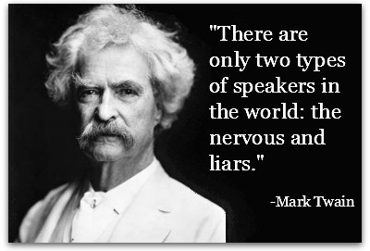
Bell Ringer 4
What is the WORST thing that could happen during your speech?

Slide 37
Plan for the Day
Speeches!
Introduction to Unit 4

Slide 38
Speech Protocol
You will all be placed in groups of 5-6. You will deliver your speech to those people and RECORD IT ON AN IPAD SO I CAN GRADE IT.
If you are not ready, you will need to make an appointment with me to deliver it.
Timer: One person in your group will need to keep track of time.
Audience Participation Graphic Organizer

Slide 39
Speeches!

Slide 40
Day 24

Slide 41
Bell Ringer 4

Slide 42
Plan for the Day

Slide 43
Day 25

Slide 44
Bell Ringer 4

Slide 45
Plan for the Day

