Slide 1
Unit 3 Days 16-20

Slide 2
Day 16 MCA Testing

Slide 3
Day 17 MCA Testing

Slide 4
Day 18 MCA Testing

Slide 5
Day 19

Slide 6
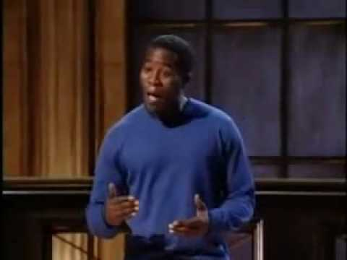
Bell Ringer 2
What was the most memorable part of the performance?
What was most effective about the presentation?
What techniques did the performer use for emphasis?

Slide 7
Plan for the Day
"FFA" movie
Introduction to Argument, Claims, and Evidence

Slide 8
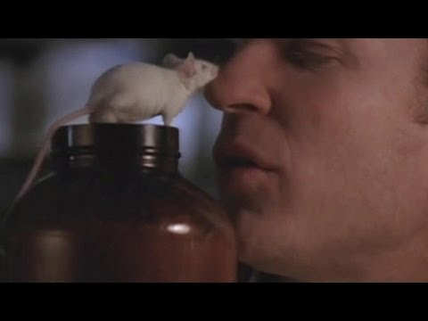
"FFA" Movie
Notes:
Skip (1:14-1:17:30)

Slide 9
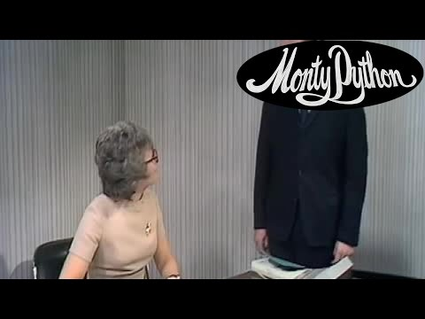
Argument, Claims, and Evidence

Slide 10
Argument
Argument: an author's opinion (AKA thesis statement)
Sometimes the same thing as the main idea, but not always.

Slide 11
Identifying the Argument
Look at the title of the text.
Read the introduction paragraph.
Read the conclusion paragraph.
Most authors will summarize their opinion in each of these places.

Slide 12
Claims
Claim: statements in support of an author's argument; answers the question "Why do you believe your opinion is true?"

Slide 13
What's the argument? What's the claim?
Justin Timberlake is the best singer because he can sing and he can dance.

Slide 14
What's the argument? What's the claim?
Justin Timberlake is the best singer because he can sing and he can dance.
Argument
Claims

Slide 15
Evidence
Evidence: anything that supports and author's claim

Slide 16
ACE Tree (on the back board)

Slide 17
Identifying the ACE
Eating candy every day is bad for your health because it causes weight gain and an increased risk for diabetes. According to Dr. Mcstuffins, if someone were to eat a Snickers bar for breakfast seven days a week, they would weigh roughly 850 pounds after one year. She also stated that if that same person continued this diet, they would be 6 times as likely to become diabetic by the age of 30.

Slide 18
Note: I made all this information up
Eating candy every day is bad for your health because it causes weight gain and an increased risk for diabetes. According to Dr. Mcstuffins, if someone were to eat a Snickers bar for breakfast seven days a week, they would weigh roughly 850 pounds after one year. She also stated that if that same person continued this diet, they would be 6 times as likely to become diabetic by the age of 30.

Slide 19
Homework: Argument Tree
Fill out the Argument and Claims for your speech.
Leave the "counter-claim" and "evidence" blank

Slide 20
Day 20

Slide 21
1A: Bell Ringer 3
What differences and similarities did you see between the “FFA” movie and short story? Make a quick Venn Diagram to explain the differences and similarities.

Slide 22
Bell Ringer 3
Identify the argument and claims in the following passage:
Cats are excellent pets. Cats are low maintenance and do not require around-the-clock supervision. Cats are also soft and warm which makes them very nice to pet.

Slide 23
Plan for the Day
Evidence continued
Counter-Claims
Fact, Opinion, Bias

Slide 24
Evidence
Just like textual evidence
Word-for-word from your research
Has a citation (At LEAST the author's last name in parenthesis)

Slide 25
Counter-Claims
Stating what the opposing side thinks and explaining why they are wrong.
AKA: Refuting the other side
“Some people think that candy is good for you because it gives you energy. However, the energy is limited and usually leads to what people in the medical profession refer to as a “sugar crash.’”

Slide 26
ACE Tree: Updated Counter-Claim
In your notes, add a “branch” for “counter-claims.”
Then create a counter-claim on your blue worksheet.

Slide 27
Homework: Continue ACE Tree
Fill in the following boxes...
Counter-claim
Evidence Row 1
Evidence Row 2→Change this to “Explanation”
Remember: Evidence=a direct quote from the article
The only blank box should be your conclusion.

Slide 28
"FFA" Movie
Notes:
Skip (1:14-1:17:30)

