Slide 1
Unit 2 Days 16-20

Slide 2
Day 16

Slide 3
Bell Ringer 6
Make a prediction about how the other greasers are going to react to Johnny’s death. Who do you think will have the most dramatic response? Explain your answers.
When you are done, please turn in your poetry analysis.

Slide 4
Plan for the Day
Chapters 10 and 11
Questioning Review

Slide 5
Chapter 10 (158-168)

Slide 6
Pause and Infer: Diagnose Ponyboy

Slide 7
What do we know about Dally?
Went to jail at the age of 10
Doesn’t care about anyone or anything
Tough
“…you get tough like me and you don’t get hurt. You look out for yourself and nothin’ can touch you…” (159)

Slide 8
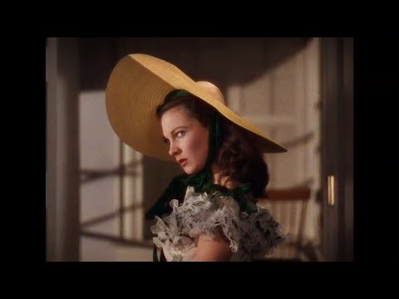
Dally and Gone with the Wind
“’I bet they were cool ol’ guys,’ he said, his eyes glowing, after I read the part about them riding into sure death because they were gallant. ‘They remind me of Dally.’”

Slide 9
Chapter 11 (169-174)

Slide 10
Questioning Amp Up
Make sure you have at least one question for every chapter.
Switch with a neighbor.
Label your neighbor’s questions as L1, L2, L3.
Switch back so the original person has their paper back.
Bump up each of your questions. L1>>L2/L3, L2>>L3

Slide 11
Work Time
Green Packet
Layers of Understanding Chart
Character Chart
Missing/Re-do Work

Slide 12
Day 17

Slide 13
Bell Ringer 7
Copy down the following chart. Then make an inference by filling out the boxes.
What the text says… | Connections/Schema
A man ran after a retreating bus, waving his briefcase frantically.
My inference…

Slide 14
Plan for the Day
Chapter 12
Wrap Up and Review: Symbolism and Inferences

Slide 15
Chapter 12 (175-188)

Slide 16
Get your life together!
Outsiders work
Missing/re-do assignments
Read your IR book

Slide 17
Finish the movie!

Slide 18
Day 18

Slide 19
Bell Ringer 8
What did you think of the ending of The Outsiders? Did it end the way you thought it would?
When you are done, turn in your bell ringers. Make sure your name is on it.

Slide 20
Plan for the Day
Finish movie
Review for the test
Symbolism
Inferences
Characterization

Slide 21
Finish Movie!

Slide 22
Your Test…
Format
Part 1: Inferences
Like yesterday’s bell ringer
Part 2: Characters’ Identity
Short answer, character traits
Part 3: Symbolism
I give you a symbol, you tell me what it means.
Part 4: Reading Comprehension
Multiple choice
Part 5: Literature Analysis
Explain quotes from the book
Part 6: Theme
What to study…
Inferences
Symbolism
Identity Notes
Rainbow Outsiders Work

Slide 23
Inference Review: Copy this into your notebook
Textual Evidence | Connections/Schema
1. 2. 3. 4. 5. | 1. 2. 3. 4. 5.
My inference…

Slide 24
Directions:
Read ONE of the poems. Then fill out the inference chart.
If you had me last year you may NOT do Poem A.

Slide 25
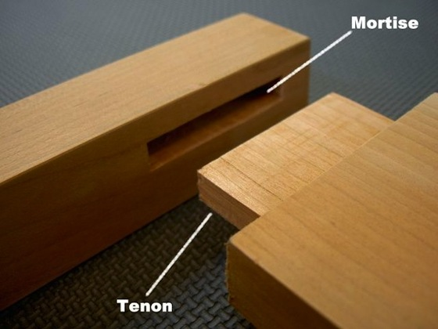
I wear a helmet
On my back.
It’s hard
And guards
Me from attack.
Or if I wheeze,
Or sneeze,
Or cough,
The shell I dwell in
Won’t fall off.
It’s glued without
A screw or mortise. I’m born with it.

Slide 26
When somebody hits me,
A crowd always cheers.
I don't understand it,
But it brings me to tears.
It thrills people silly
To throw me around
And make me go bouncing
Across the hard ground.
I'm battered by bats
Just to make the crowd shout.
I am sick of this game
It's not safe, I want out!

Slide 27
Symbolism Review: Kahoot!

Slide 28
Characterization Review: Whiteboards

Slide 29
Went to jail at the age of 10

Slide 30
The "dad" of the Greasers

Slide 31
Doesn't use his head.

Slide 32
The "pet" for the Greasers

Slide 33
Soda's best friend

Slide 34
A spy for the Greasers

Slide 35
These TWO characters like to watch sunsets

Slide 36
Got dumped by his pregnant girlfriend

Slide 37
The jokester

Slide 38
Killed Bob

Slide 39
Could be a Soc

Slide 40
Dropped out of school to work at a gas station

Slide 41
Carries a switchblade*

Slide 42
Hates violence*

Slide 43
Soc, did NOT go to the rumble

Slide 44
Most likely to go to college

Slide 45
Most likely to be forgotten as a not very important character

Slide 46
Died a hero

Slide 47
Died a hood

Slide 48
Died a drunk idiot

Slide 49
"Nothing ____ can ____"

Slide 50
Soda's horse's name

Slide 51
The Soc who started the fight; played football with Darry

Slide 52
Day 19

Slide 53
Bell Ringer 1
What did you do to prepare for the test? What is your goal score for the test (out of 10 points)?
When you are done, get out your notes to study and your work from The Outsiders.

Slide 54
Plan for the Day
Unit 2 Assessment

Slide 55
Pass in your Outsiders Work
Green Packet
Layers of Understanding Chart
Character Chart

Slide 56
Unit 2 Test
Finish the test.
Double check your work.
Make sure your name is on it.
Turn it in to the basket.
Read your IR book.

Slide 57
Day 20

Slide 58
Bell Ringer 2
How do you think the test went? What was the most difficult part? Why?

Slide 59
Plan for the Day
Finish the test
Socratic Seminar Prep

Slide 60
Finish the test

Slide 61
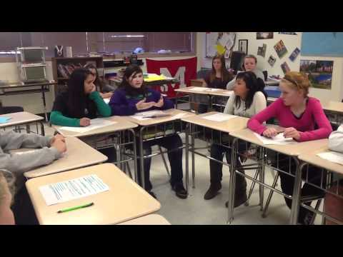
What's a Socratic Seminar?

Slide 62
How will I be graded?
 | Does not Meet Points: 1-5​​ | Needs Work Points: 6​ | Partially Meets ​ Points: 7​ | Meets Points: 8​ | Exceeds Points: 9, 10​​
Questioning​ | I need to clarify my questions so they relate directly to the text.​ | I can ask questions to clarify what the text means.​ | I can pose questions that reference the text.​ | I can pose questions that emerge directly from text evidence and clarify a peer’s contribution.​ | I can use multiple contributions to pose deeper level questions.​
Expressing Ideas​ | I need to participate by using my notes, expressing my own ideas and making my own connections.​ | I can summarize ideas from the text.​ | I can express my ideas clearly with loose connections to the text.​ | I can express my ideas clearly and persuasively using text evidence and summarize points of agreement/disagreement.​ | I can make new connections from evidence and reasoning in the dialogue.​
Generating Ideas​ | I need to listen to others and create my own responses.​ | I can reiterate what someone else said.​ | I can respond to questions in a dialogue.​ | I can use evidence from the texts to generate dialogue and build on other’s ideas.​ | I can pose questions and comments that help the dialogue go deeper.​

Slide 63
Step One: Identifying the Questions
Pick your SIX best questions from your Layers of Understanding Chart for The Outsiders
Write them out on a sheet of notebook paper, leaving at LEAST 4 lines between each question.

Slide 64
Step 2: Answer your Questions
Each of your questions should also have...
The answer, written in bullet points
Quote from the text supporting the answer with a page number
A connection that you can make to your own life (another text, personal experience, something going on in the world)

Slide 65
Step 3: Answer my questions
Around the room there are five different questions.
On the same sheet of paper and in the same format, answer each question.

