Slide 1
Day 1

Slide 2
Bell Ringer
Who are you? (Be specific and still write 3-5 sentences.)
When you are done, turn in your summary of the Hunger Games article. Then get out your materials for your book talk and your notes on questioning.

Slide 3
Plan for the Day
Book Talks
Unit 2 Introduction
Identity Artwork

Slide 4
Book Talks
Set up questioning sheet
Volunteer protocol

Slide 5
Protocol
Questioning Sheet
Order of presentations
Audience expectations

Slide 6
Day 2

Slide 7
Bell Ringer
What are your goals for the next unit? What are you most looking forward to?
When you are done, please turn in your bell ringers.

Slide 8
Plan for the Day
Book Talks

Slide 9
Continue Book Talks

Slide 10
Day 3

Slide 11
Bell Ringer 1
Make a prediction about what you think The Outsiders will be about. You can base this on the following information:
-Book Title
-Book Cover-->
-What I've told you in the past

Slide 12
Plan for the Day
Finish book talks
Introduction to Unit 2
Video Jigsaw

Slide 13
Introduction to Unit 2
Big Ideas
Identity
Inferences
Symbolism
Reading
The Outsiders
Nonfiction articles
Poems
Projects and Assignments
Socratic Seminar
Personal Narrative
Test on Inferences
Nonfiction Quiz

Slide 14
The Outsiders Teaser

Slide 15
S.E Hinton (the author)
Turn and talk to the person next to you.
Based on your knowledge of other authors, what can you guess about SE Hinton?

Slide 16
SE Hinton
Wrote The Outsiders when she was still in high school (16 yo)
Based the story on what she saw in her neighborhood
Published the book when she was 18 and it was IMMEDIATELY successful
Purposefully chose to go by “SE”
SE=Susan Eliose

Slide 17
Fun Fact:
Mr. Buryska knows SE Hinton.
Mrs. Klugherz lived in the same town as SE Hinton and some of her friends were in a movie based on another SE Hinton book.

Slide 18
Video Jigsaw
"The Danger of a Single Story" | "Can Prejudice Ever be a Good Thing?" | "How to Overcome our Biases? Walk Boldly Toward Them."
Chimananda Adichie, a Nigerian woman, talks about how often prejudices are started by people only learning one story. | Paul Bloom looks at the psychology of prejudice and how it is one of our main motivators. | Verna Myers talks about the violence against black men, and how the world needs to accept their biases.

Slide 19
Day 4

Slide 20
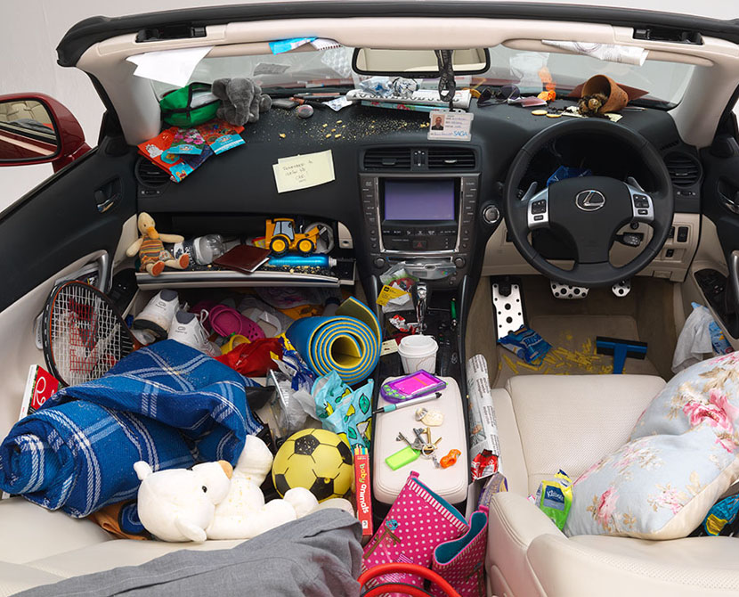
Bell Ringer 2
Based on this picture, what can you infer about the person who owns the car?
List 3-5 inferences.

Slide 21
Plan for the Day
Continue video jigsaw
Inferences

Slide 22
Continue Video Jigsaw
Re-watch the video and fill out the worksheet.
Briefly summarize your video for your group.
With your group, make a word web (or other concept map) that connects the ideas in your videos.
CHALLENGE: Make predictions about how The Outsiders will connect to the videos and add it to your concept map in a different color.

Slide 23
Inferences
An inference is an educated guess about unstated ideas in a passage.
We use these because authors don’t always clearly state every idea in a story or article.
drawing conclusions
forming generalizations
making predictions

Slide 24
Drawing Conclusions
Like putting a puzzle together, when you draw conclusions you piece together information stated in the passage with information that is implied or with guesses you make from your own schema (life experiences.)

Slide 25
Drawing Conclusions Practice!
Read the sentence below:
“He and the other workers paid a Chinese cook to import pressed duck, dried squid, and the other things needed to prepare proper meals.”
What conclusions can you draw about the workers in this sentence?

Slide 26
Forming Generalizations
A generalization is not a guess. It is a valid judgment based on evidence.
Valid generalizations use words such as:
many often some few
Invalid generalizations use words such as:
all always every never

Slide 27
Forming Generalizations Practice!
Suppose you read a magazine article that tells about new soccer leagues that are being formed in many cities across the United States. Based on this information, which generalization would be valid?
Soccer is becoming a popular sport in the U.S.
Soccer is becoming a popular sport world-wide.
Soccer is the most popular sport in the U.S.

Slide 28
Making Predictions
When you make a prediction you guess what might happen based on information in the story and from your own schema (experience).
As you read, try to guess what will happen next, making note of:
details about character, plot, and setting
what a character says and does
hints of what might happen in the future

Slide 29
Making Predictions Practice!
Read the story below:
The curtains were about to open, but the play could not begin without Gina. She had a starring role. Mrs. Landis nervously watched the door. She hoped that at any second it would swing open and Gina would rush in. Mrs. Landis tried to ignore the fact that the play should have started 10 minutes ago, but the rustling and whispering from the other side of the curtain grew louder. The audience was growing restless! “Bring me Gina’s costume, please,” Mrs. Landis said to a stagehand. As she waited, Mrs. Landis whispered, “I sure hope that skirt fits me.”
What do you predict Mrs. Landis will do? What clues helped you make your prediction?

Slide 30
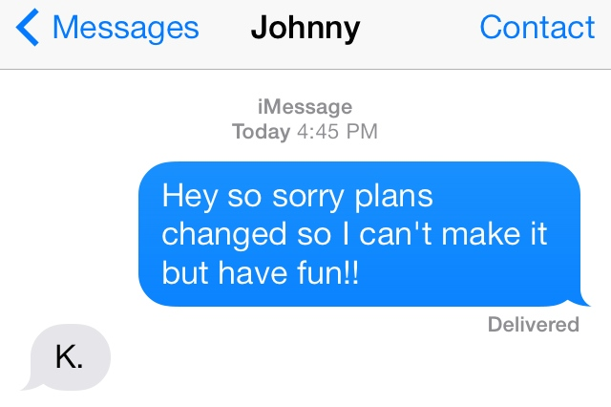
Real Life Inferences
You are texting your boy/girlfriend. They want to hang out, but you have to finish your Independent Reading Project so you can’t hang out.

Slide 31
Inferences in Real Life: People Watching

Slide 32
Inferences and The Outsiders

Slide 33
Day 5 https://www.youtube.com/watch?v=VOvDTCbcHe0

Slide 34
Bell Ringer 3
What is the difference between personality and identity? Explain your answer in 3-5 sentences.
When you are done, please turn in your yellow Outsiders inference worksheet.

Slide 35
Plan for the Day
Start reading The Outsiders!

Slide 36
Enriched: Parent Letter

Slide 37
Reminder:
If you have NOT completed your IR project, you have until the end of the week to turn anything in OR to make an appointment with me to do your speech.

Slide 38
Plot Preview
The novel is about a boy names “Ponyboy” and his gang of ruffians called “Greasers.” They are constantly fighting the other gang in town called the “Socs” (short of “Socials”).
It does not go well.

Slide 39
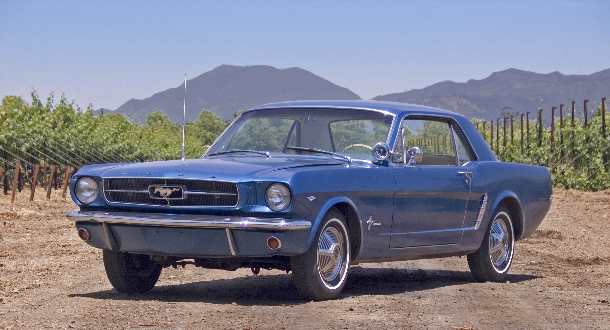
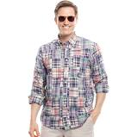
How to be a Soc:
Dress like this guy→
Have, or pretend to have a lot of money
Drive a sweet ride
Be a jerk, especially to people with less money than you

Slide 40
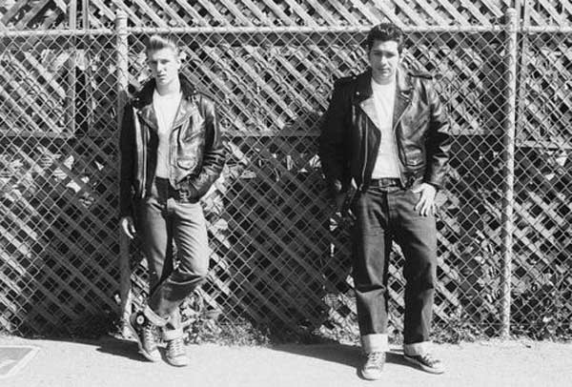
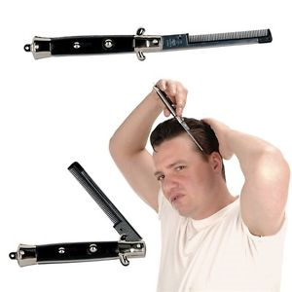
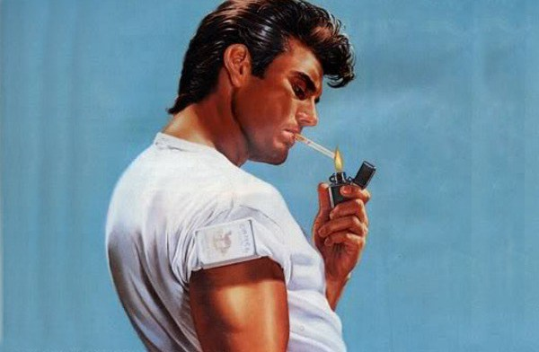
How to be a Greaser
Spend 80% of your time leaning against fences
Have a tragic home life (your parents probably died or are jerks)
Wear leather, white t-shirts, Converse, and slicked hair
Smoke a lot (gross)

Slide 41
Let’s get ready to rumble!!!!!!!!!!
(That joke will make sense later, I promise.)
Chapter 1
While we read, pay close attention to the characters.

Slide 42
Paperwork for The Outsiders
ALL OF THESE ASSIGNMENTS ARE DUE DECEMBER 21ST OR 22ND. YOU ARE RESPONSIBLE FOR KEEPING UP WITH THE WORK AND CLASS TIME IS LIMITED.
Journal
Layers of Understanding Chart
Character Chart

Slide 43
Character Activity
What is important to your character?
Appearance
Character Traits
Words/Actions
Ponyboy
Sodapop
Darry
Two-Bit Matthews
Johnny
Steve
Dally

