Slide 1
Unit 1 Days 6-10

Slide 2
Day 6

Slide 3
Bell Ringer
If a teacher is using a section of Beyoncé's album Lemonade to teach her students about figurative language, would that break copyright?
Why or why not?
Answer the prompt in 3-5 sentences.

Slide 4
Pass in your music streaming article

Slide 5
Plan for the Day
Essay pre-assessment
Read

Slide 6
Essay Pre-Assessment
Directions:
Write a 5 paragraph essay.

Slide 7
Day 7

Slide 8
Bell Ringer
Think of a job that you may want to have in the future. How does that job involve writing?
When you are done, please get your notebook page set up. The title is "6 Traits of Writing."

Slide 9
Plan for the Day
What makes a good writer?
6 Traits Stations
Formal E-mails on Office 365

Slide 10
What makes a good writer?
STEP 1: Brainstorm by yourself.
STEP 2: Share your list with your table.
STEP 3: Pick your top 10 qualities and write them on sticky notes.

Slide 11
6 Traits of Writing
Ideas: the main message
Organization: the structure of your writing
Voice: the author's tone or "flavor"
Word Choice: vocabulary
Sentence Fluency: the rhythm
Conventions: grammar, spelling, punctuation

Slide 12
6 Trait Sort
Take your table's list of the qualities of a good writer and label them with the 6 Traits.

Slide 13

Stations
Station 1: Organization
Station 2: Voice
Station 3: Sentence Fluency
Station 4: Conventions A
Station 5: Conventions B

Slide 14
Day 8

Slide 15
Bell Ringer
What is the most important of the 6 Traits? Which trait do you struggle with the most as a writer?

Slide 16
Plan for the Day
Finish 6 Traits stations
Marking the text
Textual evidence

Slide 17
Finish 6 Trait Stations
Station 6: Ideas
Station 7: Word Choice
Station 8: Book Hooks

Slide 18
Formal E-mails
To practice the 6 Traits (or the 4 that we focused on today) you are going to write me a formal e-mail using Office 365.
You may pick from one of the following prompts:
  What's better: cats or dogs? Why?
  What are you looking forward to during Homecoming week?
  What's your favorite subject? Why?
  Other

Slide 19
Day 9

Slide 20
Bell Ringer
A DAY: What are you plans for homecoming? For the weekend?
B DAY: What did you do for homecoming? If you didn't do anything for #hoco, what did you do this weekend?

Slide 21
Plan for the Day
Marking the Text
Textual Evidence

Slide 22
Remember the Taylor Swift article?

Slide 23
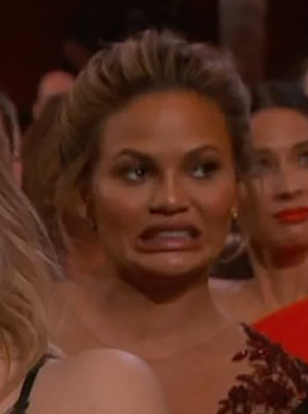
Marking the Text (Feedback)

Slide 24
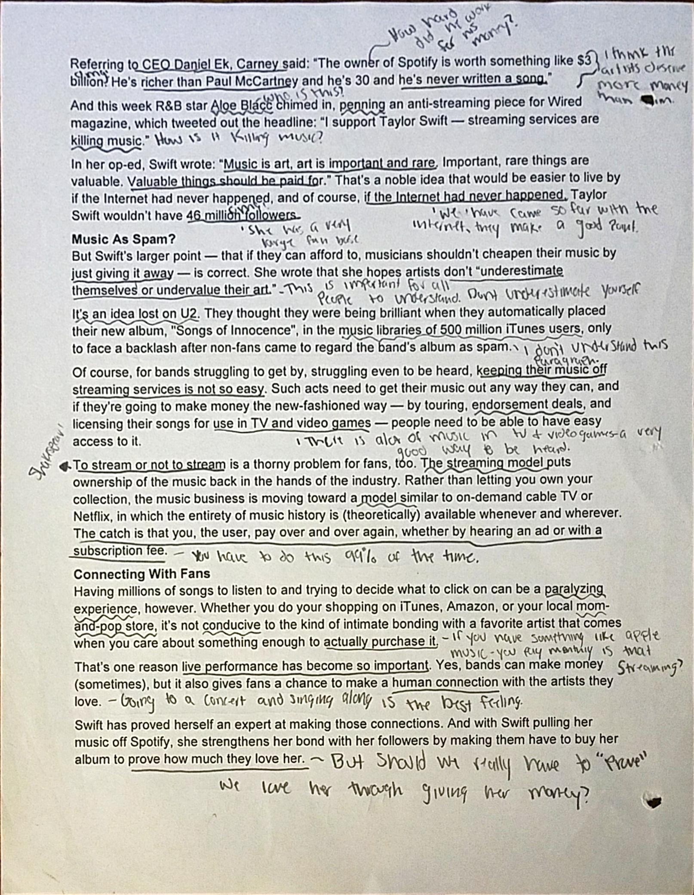
Good Example

Slide 25
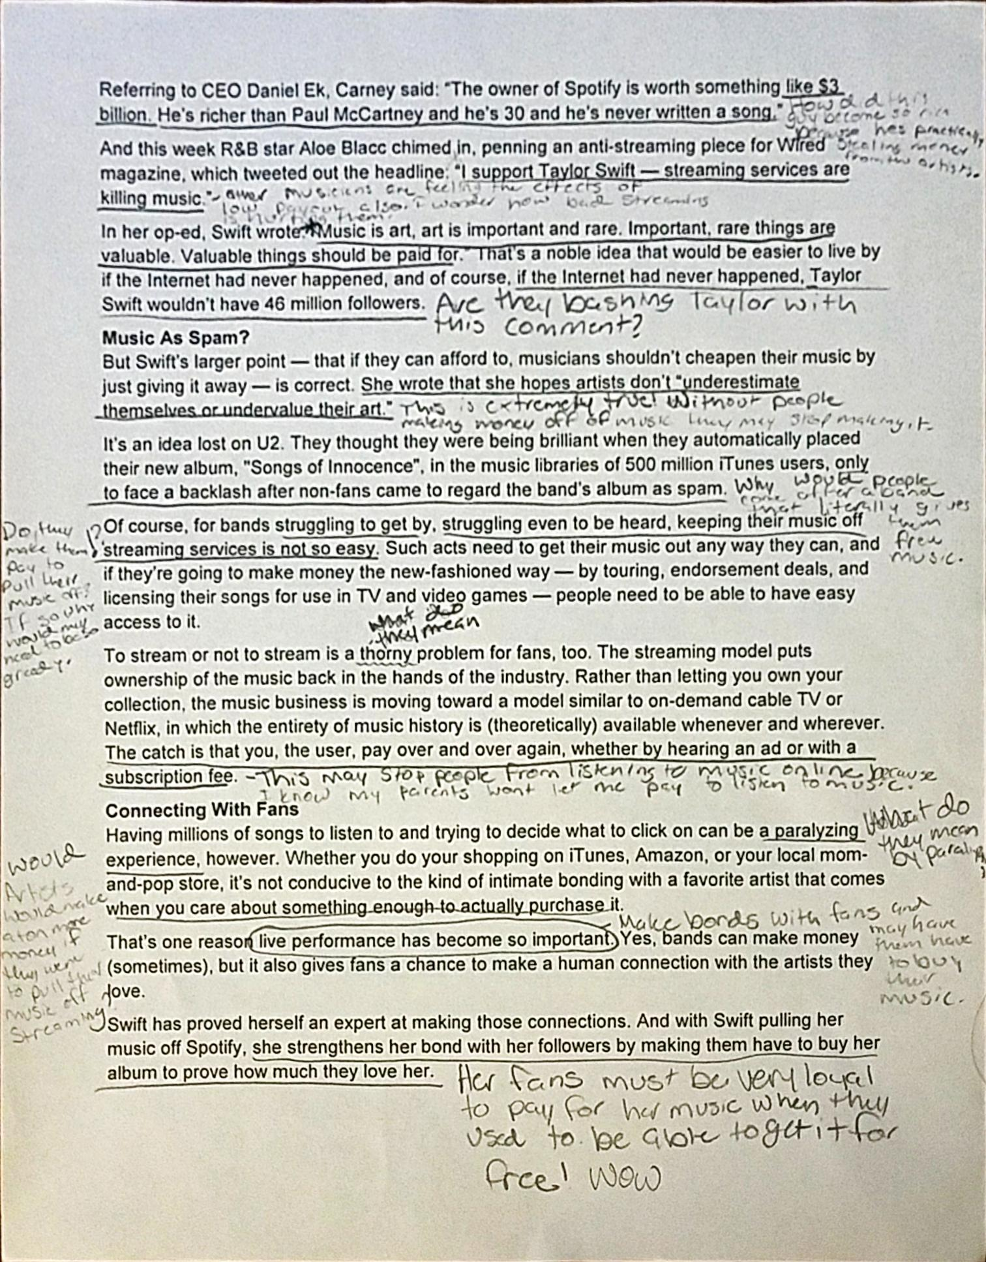
Good Example

Slide 26
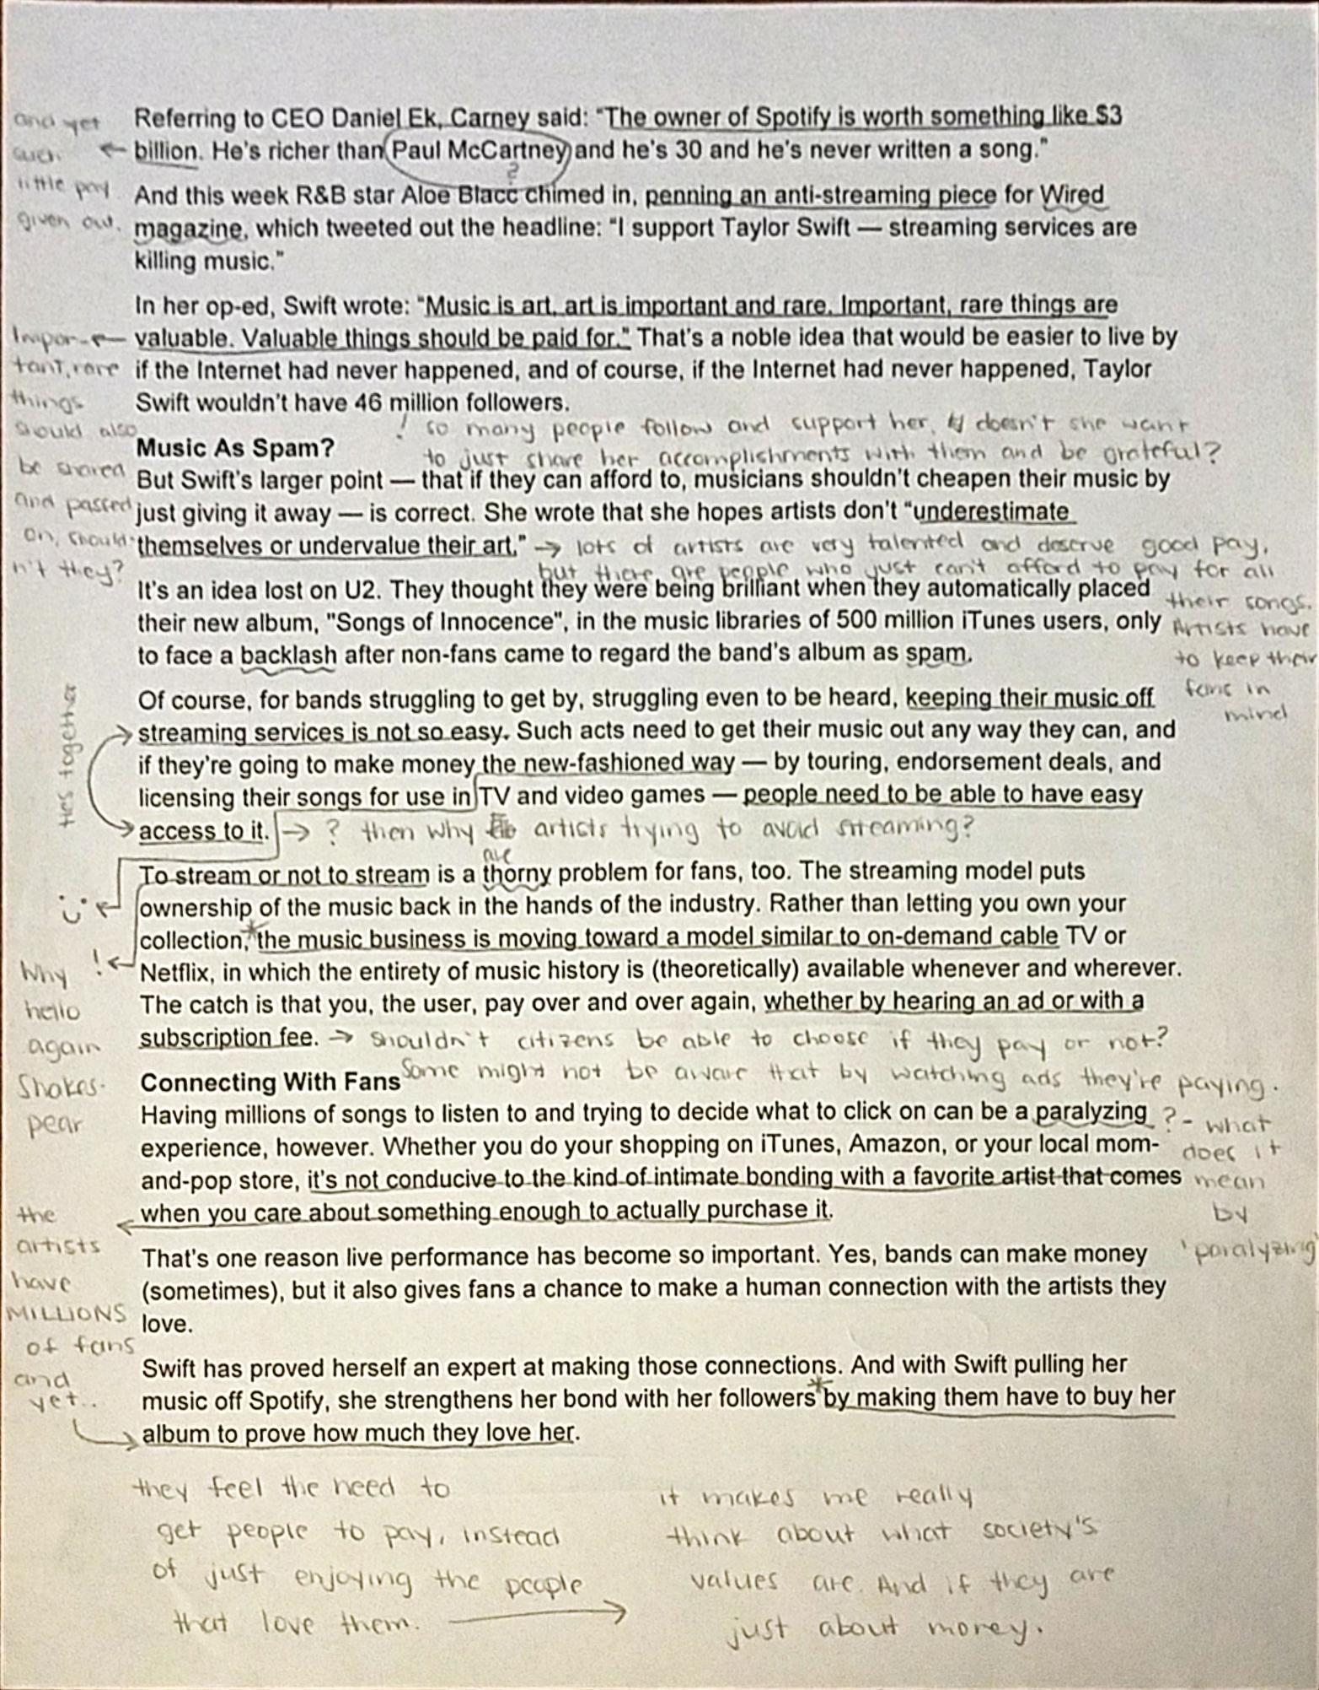
Good Example

Slide 27
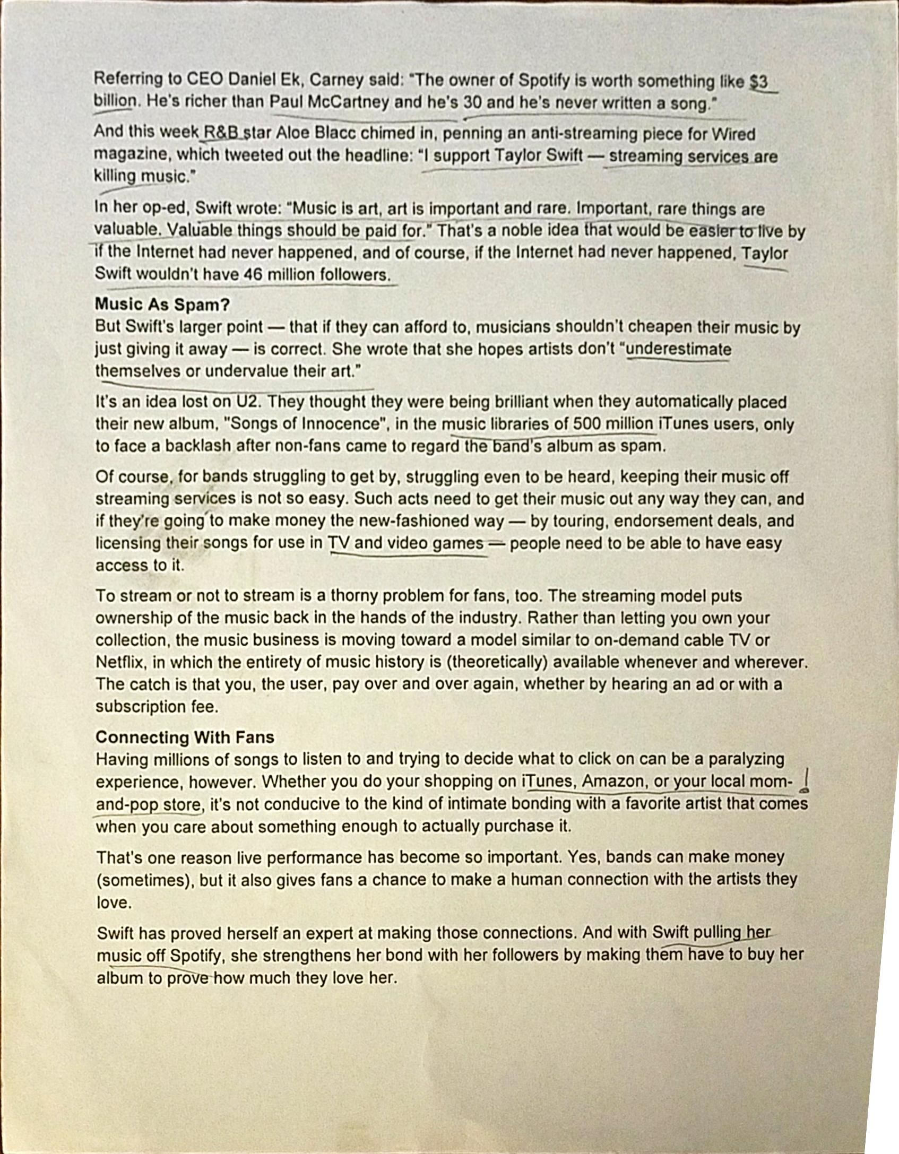
Not so Good Example

Slide 28
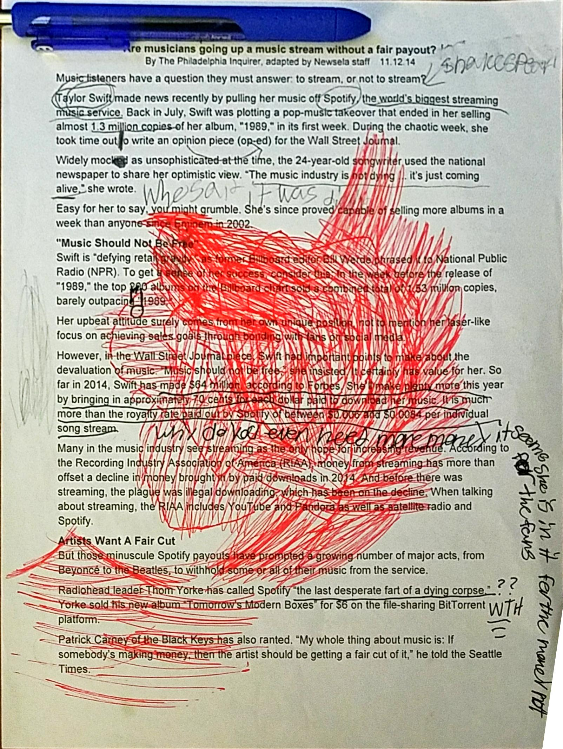
Another Not so Good Example

Slide 29
Fix your T-Swift Article

Slide 30
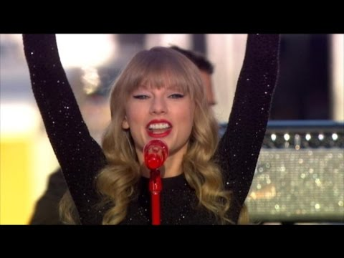

Slide 31
Table Discussion
If you are the YOUNGEST person at your table, take notes on the conversation.
Do you think what Taylor Swift did was “fair”?
How do you think the reaction to T-Swift’s decision be different if she weren’t so successful?

Slide 32
Discussion Questions
How do you listen to music? Do you have a Spotify? ITunes? CDs?
Now that you read the article, do you think what Taylor Swift did was fair? Compare this answer to your pod’s answer from the video.
Do you think music should be free? Why or why not?
As a listener of music, what do you think about streaming services like Spotify? Does access to music change what you listen to?
What do you think Taylor Swift means when she says “The music industry is not dying...it’s just coming alive”?

Slide 33
Kahoot!
https://play.kahoot.it/#/k/e092c2fc-a42f-4514-a8e6-4301aeb468dc

Slide 34
FreeRice.com

Slide 35
Day 10

Slide 36
Bell Ringer
What do you remember about plot?
If you are struggling, try to answer the following questions:
  What is plot?
  What are the six parts of the plot diagram?
  What does a plot diagram look like?

Slide 37
Plan for the Day
Plot Review
"After Twenty" by O. Henry
Plot Diagrams

Slide 38
Plot Review
Plot: a series of events that creates a story

Slide 39
The Six Parts of the Plot Diagram
Exposition: background information; characters and setting introduced
Introducing Incident: conflict/problem introduced
Rising Action: conflict builds
Climax: most interesting moment; conflict reaches its peak
Falling Action: conflict starts to resolve
Resolution: conflict ends

Slide 40
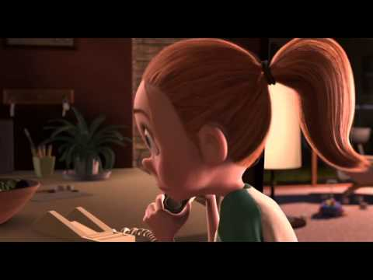
Plot Diagram Practice

Slide 41
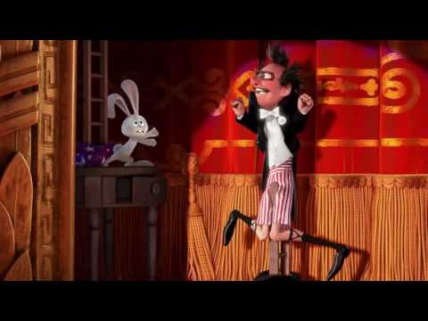
Plot Diagram Practice 2

Slide 42
“After Twenty Years” by O. Henry (Part 1)
As we read this story, identify the main conflict of the story.

Slide 43
"After Twenty Years“ (Part 2)
As we read, make a list of the "big" events of the story. Try to come up with at least 10.

Slide 44
Plot Diagram Practice
Step 1: Share your plot events with your table.
Step 2: Narrow down the list to your top 10 events. (EACH GROUP MUST HAVE 10 EVENTS).
Step 3: Write the events on sticky notes (One event per note).
Step 4: Plot Diagram Competition

