Slide 1
Unit 1: Days 11-15

Slide 2
Day 11

Slide 3
Bell Ringer
What did you think of “After Twenty Years”?
Answer the prompt in 3-5 sentences. Then read your book.

Slide 4
Plan for the Day
Class Updates: Reading Time and Late Assignments
Plot Competition
Reading Strategies: Connections and Vocabulary
O. Henry Biography

Slide 5
Class Updates
Reading Time
IR Projects (copies coming to you next class)
Late Assignments

Slide 6
Plot Competition

Slide 7
Reading Strategies: Connections and Vocab.
Connections
This reminds me of…
This relates to my life because…
Vocabulary
Highlight/Squiggle under any word you don’t understand

Slide 8
O. Henry Biography
While we read, highlight/squiggle each word that you don't immediately know the definition of.
Also make note of any connections you make between the biography and "After Twenty Years."

Slide 9
Vocabulary Study

Slide 10
Day 12

Slide 11
Bell Ringer
How would "After Twenty Years" be different if it were set in 2017?
Explain your answer in 3-5 sentences.
Then read your IR book.

Slide 12
Plan for the Day
Vocabulary Study
Free Write
Introduction to questioning

Slide 14
Continue Vocabulary Study

Slide 15
Free Write
If you were in Jimmy's position, what would you have done?
Do you think Jimmy did the right thing? Why or why not?

Slide 16
Day 13

Slide 17
Bell Ringer
Why is it important to make connections while you read?
Remember, I shouldn’t have to tell you what to do next!

Slide 18
Plan for the Day
Visualizing
Introduction to questioning

Slide 20
Visualizing
A reading strategy
Picturing characters, setting, moments, etc. as you read
“The movie in your head.”

Slide 21
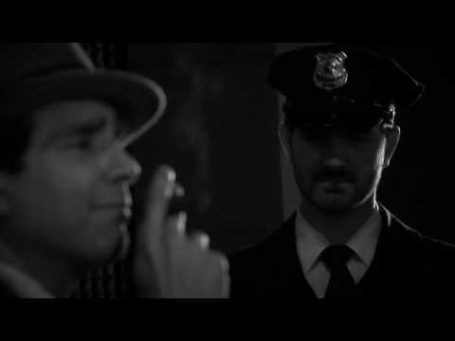
“After Twenty Years” Video

Slide 22
Turn and Talk: Visualizing
How does this video change how you understand or imagine the story?
How is the video different from what you pictured as you read?

Slide 23
Introduction to Questioning Sort
With your team, sort the questions.
I am not going to tell you HOW you have to sort them. There is no wrong way to do this...the first time.

Slide 24
Group Sort Gallery Walk
Try to figure out how each group sorted their questions.

Slide 25
Costa's Levels Questioning
(An AVID strategy)

Slide 26
Level 1
"Look it up" Questions
Clear answers, usually black and white

Slide 27
Level 2
"Read between the lines"
You interpret/infer the answer
You already know the information, but now you are working with it.

Slide 28
Level 3
Open-Ended
No clear answer
Usually opinions

Slide 29
Re-sort the Questions

Slide 30
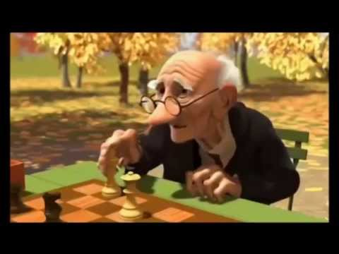
Questioning Practice

Slide 31
Exit Ticket
On a HALF sheet of paper, write one of each level of questions about "Geri's Game."

Slide 32
Day 14

Slide 33
Bell Ringer
Take the following level 1 question and re-write it so it is level 2. Then re-write it as a level 3.
Label the parts of the plot diagram.
Maybe if I put something in red here, it will automatically remind you to do something after your bell ringer.

Slide 34
Plan for the Day
Library
Wrap Up Questioning
"The Circuit“ Nonfiction preparation
Predictions

Slide 35
Library Trip

Slide 36
Evaluating Our Questions
We are going to sort your questions from "Geri's Game."
With your team, decide if the question read is Level 1, 2, or 3.
Then write your answer on your white board.

Slide 37
Reading Strategies Notes
Predict: a guess about the future
Visualize: the movie in your head
Question: Costa's 3 Levels
Connect: how does the reading relate to you, the world, or other texts?
Identify: plot, setting, theme, tone, symbolism, vocab...
Infer: reaching a conclusion based on fact or evidence
Evaluate: deciding what your opinion is

Slide 38
Reading Strategy Sentence Starter Sheet

Slide 39
While we read...
Use TWO of each of the sentence starters to practice all the reading strategies. You should have 14 by the end of class.

Slide 40
“Picking Strawberries: Could You Do It?” (295)

Slide 41
String Tying Challenge

Slide 42
“Cesar Chavez: He Made a Difference” (290)

Slide 43
Reading Strategy Work Time

Slide 44
Turn and Talk
Based on our nonfiction readings, what is our next story going to be about?

Slide 45
Next Class...
We are going to read the short story "The Circuit."
I might cry.

Slide 46
Day 15

Slide 47
Bell Ringer
What are you doing over MEA break?

Slide 48
Plan for the Day
“The Circuit”
Plot review
Theme review

Slide 49
"The Circuit"

Slide 50
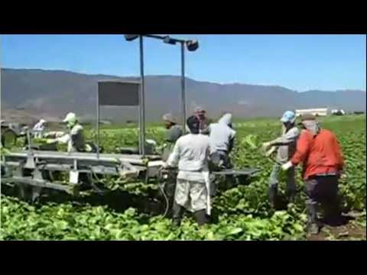
Migrant Camps

Slide 51
"The Circuit" Plot Diagram
On the back of your reading strategies, please complete a plot diagram for "The Circuit."

Slide 52
Theme
Theme: the main idea; the lesson the author wants the reader to understand.

Slide 53
Themes vs. Topics
Theme is NOT one word (example: family, love, revenge).
TOPICS are one word. THEMES are a full sentence about a topic.

Slide 54
Identifying Theme
Read the text.
Make a list of topics.
Pick ONE topic.
Finish the sentence "The author believes that..."

Slide 55
Practice Identifying Theme
Movie | Topics (List 4) | Theme "The author believes that..."
https://www.youtube.com/watch?v=tvKzyYy6qvY&list=PLGniCcA0UBfEa6j7ZljW_lceQM83kU_94

Slide 56
Homework: Songs and Theme
Pick 3-5 songs. Then identify the theme in all three. Explain WHY you chose that theme.

Slide 57
Grading Scale
3 songs=7 points
5 songs= 10 points
Example: "Tearin' Up my Heart" by NSYNC
Love is both a good and bad thing; it can cause pain, but also happiness.
The song says, "It's tearin' up my heart when I'm with you, but when we are apart I feel it too" which means that both being with and away from the person causes pain.

